Slide 1
Operating Systems
Ch 1: Introduction
Dr. 何明昕 HE Mingxin, MX, Max
Send your email to c.max@yeah.net with
a subject like: OS-id-Andy: On What …
Download from c.program@yeah.net
/文件中心/网盘/OperatingSystems26S
Book site: https://codex.cs.yale.edu/avi/os-book/OS10/index.html

Slide 2
Chapter 1: Introduction
What Operating Systems Do
Computer-System Organization (rev)
Computer-System Architecture (rev)
Operating-System Operations
Resource Management
Security and Protection
Virtualization
Distributed Systems (*)
Kernel Data Structures
Computing Environments
Free/Libre and Open-Source Operating Systems (*)

Slide 3
Objectives
Describe the general organization of a computer system and the role of interrupts
Describe the components in a modern, multiprocessor computer system
Illustrate the transition from user mode to kernel mode
Discuss how operating systems are used in various computing environments
Provide examples of free and open-source operating systems (*)

Slide 4
What Does the Term Operating System Mean?
An operating system is “fill in the blanks”
What about:
Car
Airplane
Printer
Washing Machine
Toaster
Compiler
Etc.
操作系统 vs 运作系统 ？

Slide 5
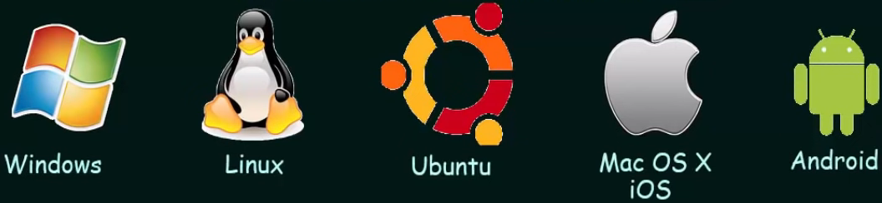
What is an Operating System?
An Operating System (OS) is a program that manages the computer hardware
It also provides a basis for Application Programs
A program that acts as an intermediary between computer user and computer hardware
Notes:
Manager: manage a computer’s hardware
Purpose: to provide an environment in which a user can execute programs in a convenient and efficient manner

Slide 6
What is an Operating System?
A program that acts as an intermediary between a user of a computer and the computer hardware
Operating system goals:
Execute user programs and make solving user problems easier
Make the computer system convenient to use
Use the computer hardware in an efficient manner

Slide 7
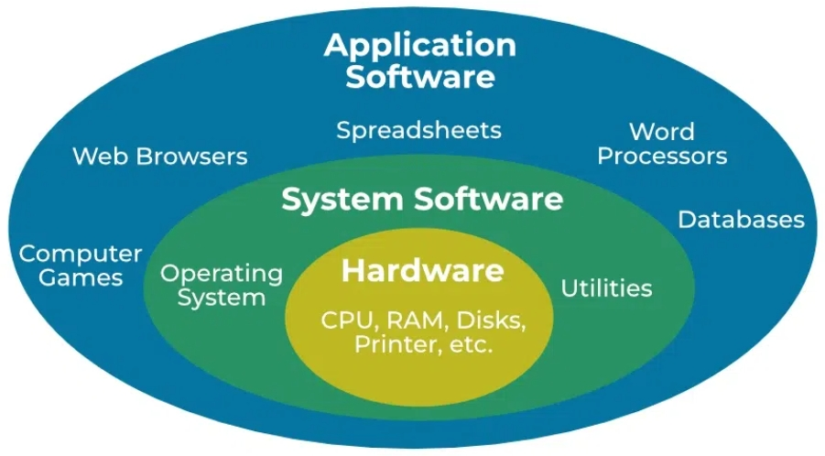
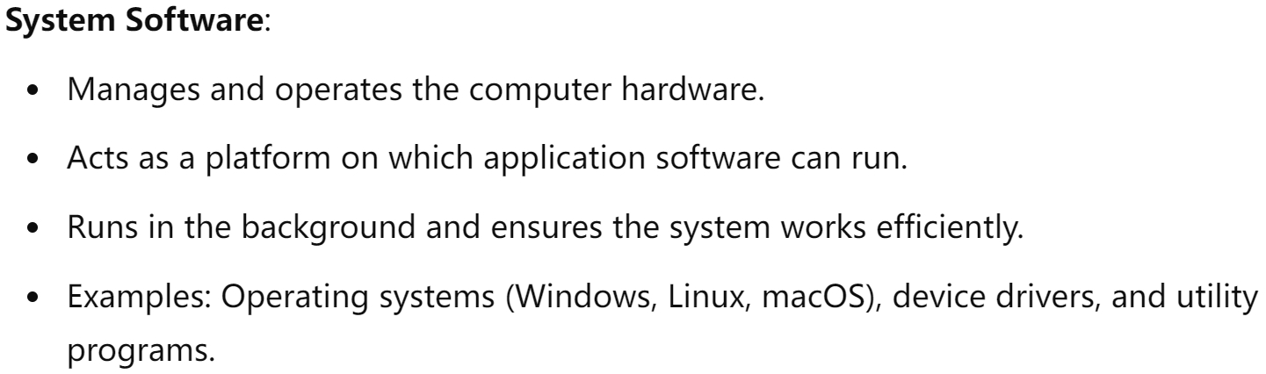
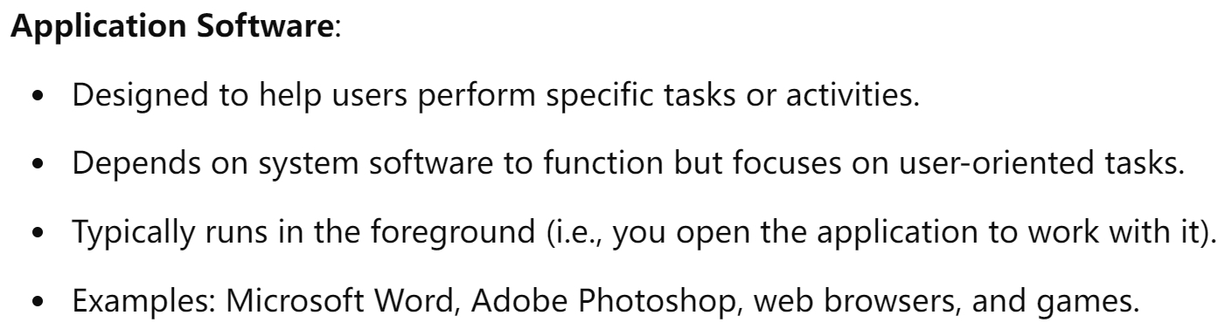
What is an Operating System?

Slide 8
Computer System Structure
Computer system can be divided into four components:
Hardware – provides basic computing resources
CPU, memory, I/O devices
Operating system
Controls and coordinates use of hardware among various applications and users
Application programs – define the ways in which the system resources are used to solve the computing problems of the users
Word processors, compilers, web browsers, database systems, video games
Users
People, machines, other computers

Slide 9
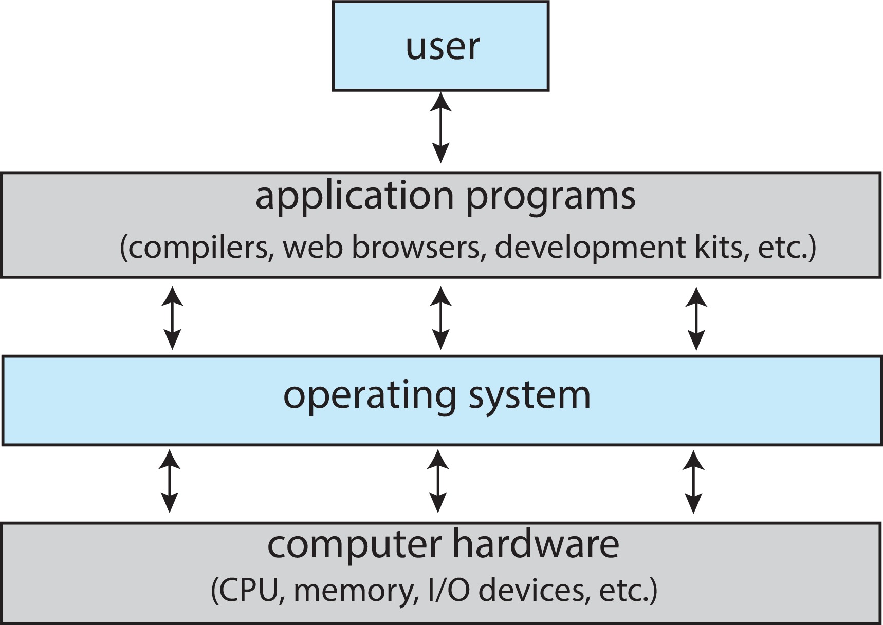
Abstract View of Components of Computer

Slide 10


Four Components of a Computer System
If no OS, you must manually tell the computer hardware!
Has to tell the hardware that he wants to do something!
Resources like CPU, Memory, I/O devices
Notes:
System programs are the programs that are used to directly command or modify computer hardware.
Application programs are the programs that are used to perform a specific task and that can be directly used by users.
Just double clicked on the Microsoft word, and then the rest of the things, the operating system takes care of it!
All the underlying things that has to happen, and the communication that has to happen between the hardware the user is taken care by the OS

Slide 11



What is an Operating System?
Operating system goals:
Execute user programs and make solving user problems easier
Make the computer system convenient to use
Use the computer hardware in an efficient manner
Convenience
Efficiency
Security

Slide 12
What Operating Systems Do — User view
One PC user want convenience, ease of use and good performance
Don’t care about resource utilization
But shared computer such as mainframe or minicomputer must keep all users happy
Handheld computers are resource poor, optimized for usability and battery life
Some computers have little or no user interface, such as embedded computers in devices and automobiles
Notes:
Most computer users sit in front of a PC, such system is designed for one user to monopolize its resources; The goal is to maximize the work that the user is performing. In this case, the OS is designed mostly for ease of use
Resource utilization------how various hardware and software resources are shared
Mainframe: these users share resources and may exchange information------OS is designed to maximize resource utilization
Maximize resource utilization: assure that all available CPU time, memory, and I/O are used efficiently, and that no individual user takes more than her fair share
Compromise between individual usability and resource utilization

Slide 13
What Operating Systems Do — System view
OS is a resource allocator
Manages all resources
Example of resources?
Decides between conflicting requests for efficient and fair resource use
Examples of conflicting requests?
OS is a control program
Controls execution of programs to prevent errors and improper use of the computer, especially for I/O
Examples of improper use of computer?
Notes:
All resources: CPU time, memory space, file-storage space, I/O devices, and so on
Facing numerous and possibly conflicting requests for resources, the OS must decide how to allocate them to specific programs and users so that it can operate the computer system efficiently and fairly

Slide 14
Computer Startup
Where is the OS stored on the computer?
What operation or program starts the OS?
bootstrap program is loaded at power-up or reboot
Loads operating system kernel and starts execution
Locate the operating-system kernel and load it into memory
Some services are provided outside of the kernel, by system software
Typically stored in ROM, generally known as firmware
Notes:
The bootstrap program must know how to load the OS and how to start executing that system
Once the kernel is loaded and executing, it can start providing services to the system and its users

Slide 15
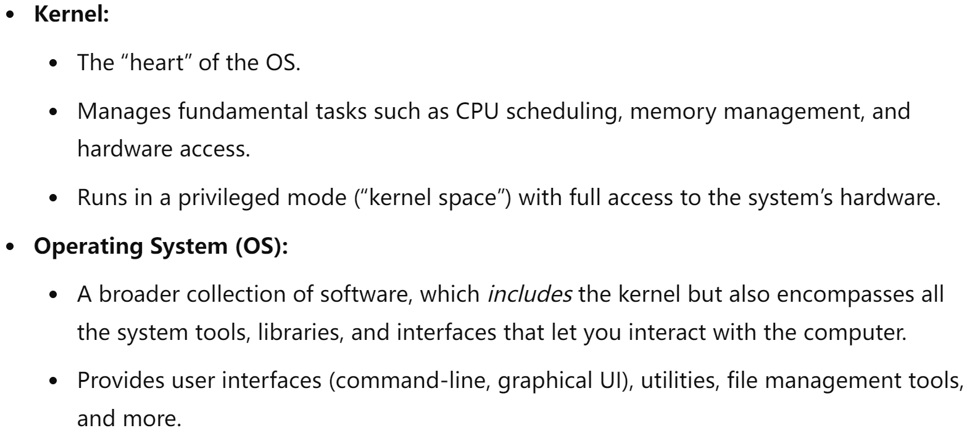
Computer Startup
How they differ between the kernel and operating system?
The kernel is the core component of an operating system (OS), but the operating system as a whole is more than just the kernel.
Notes:
The kernel is the fundamental core that performs crucial operations like memory management and process scheduling.
The operating system encompasses the kernel plus all system-level programs and user interfaces—everything you use to interact with and manage the computer.

Slide 16
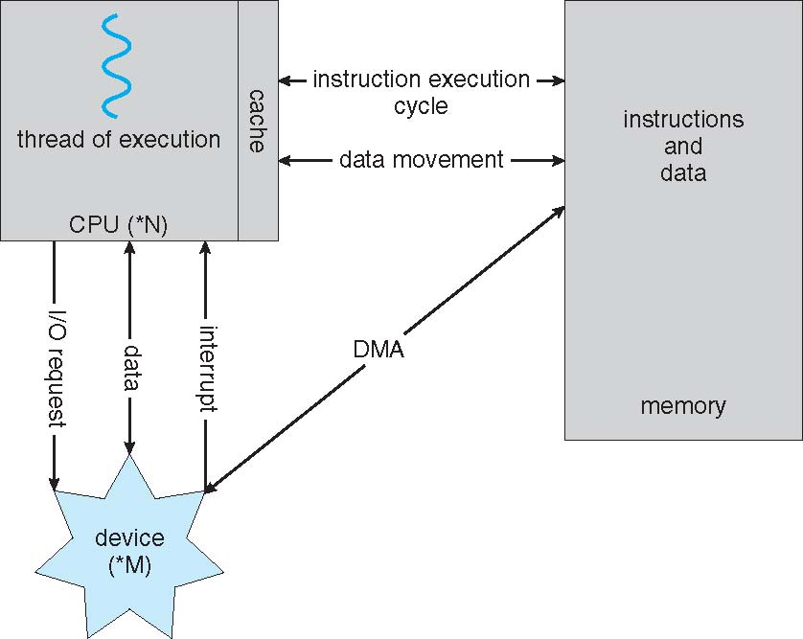
How a Modern Computer Works
instruction-execution cycle
Fetch-Decode–Execute mode
Notes:
The CPU executes a program in a Fetch-Decode –Execute mode by bringing instructions from Memory. So your program has to get loaded into memory, from the Disk.
Generally, both programs and executable files are stored in the Disk. This is where the I/O comes into the picture.
First fetches an instruction from memory and stores that instruction in the instruction register
The instruction is then decoded and may cause operands to be fetched from memory and stored in some internal register
After the instruction on the operands has been executed, the results may be stored back in memory

Slide 17
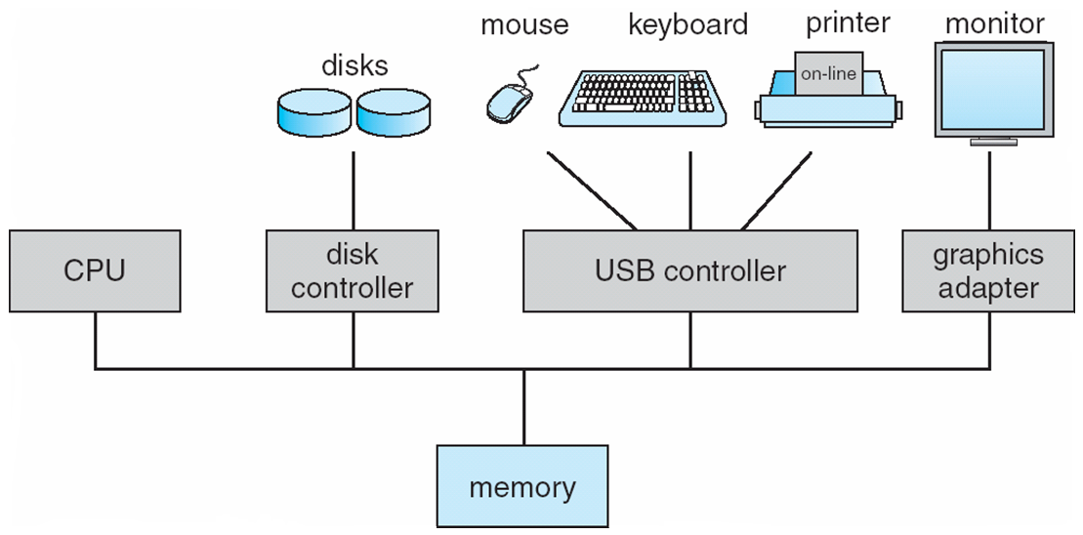
Computer System Organization
I/O devices
Buffer
System bus
An I/O operation is initiated by CPU and the I/O controllers take care of transferring and completing the I/O operation.
The devices operate at wide-ranging data transfer speed and also many different interface standards.
It is overloading on the part of CPU to deal with these devices directly. I/O controllers play a bridging role between CPU, Memory and I/O devices by taking care of all kinds of communication.
Due to heterogeneity of the devices, each device/type of interface requires an I/O Controller
Notes:
Each device controller has a local buffer
CPU moves data from/to main memory to/from local buffers
I/O is from the device to local buffer of controller.

Slide 18
Computer System Organization
One or more CPUs, device controllers connect through common bus providing access to shared memory
Each device controller is in charge of a particular device type
The CPU and the device controllers can execute concurrently, competing for memory cycles
To ensure orderly access to the shared memory, a memory controller is provided whose function is to synchronize access to the memory
Buffer

Slide 19
Storage Structure
Main memory – only large storage media that the CPU can access directly
Random access
Typically volatile
Typically random-access memory in the form of Dynamic Random-access Memory (DRAM)
Secondary storage – extension of main memory that provides large nonvolatile storage capacity

Slide 20
Storage Structure (Cont.)
Hard Disk Drives (HDD) – rigid metal or glass platters covered with magnetic recording material
Disk surface is logically divided into tracks, which are subdivided into sectors
The disk controller determines the logical interaction between the device and the computer
Non-volatile memory (NVM) devices– faster than hard disks, nonvolatile
Various technologies
Becoming more popular as capacity and performance increases, price drops

Slide 21
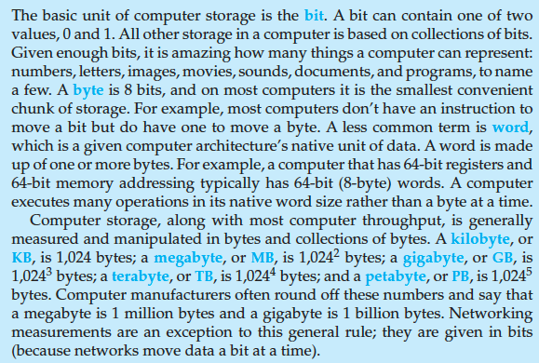
Storage Definitions and Notation Review
The basic unit of computer storage is the bit. A bit can contain one of two
values, 0 and 1. All other storage in a computer is based on collections of bits.
Given enough bits, it is amazing how many things a computer can represent:
numbers, letters, images, movies, sounds, documents, and programs, to name
a few. A byte is 8 bits, and on most computers it is the smallest convenient
chunk of storage. For example, most computers don’t have an instruction to
move a bit but do have one to move a byte. A less common term is word,
which is a given computer architecture’s native unit of data. A word is made
up of one or more bytes. For example, a computer that has 64-bit registers and
64-bit memory addressing typically has 64-bit (8-byte) words. A computer
executes many operations in its native word size rather than a byte at a time.
Computer storage, along with most computer throughput, is generally
measured and manipulated in bytes and collections of bytes. A kilobyte, or
KB , is 1,024 bytes; a megabyte, or MB, is 1,024² bytes; a gigabyte, or GB, is
1,024³ bytes; a terabyte, or TB, is 1,024⁴ bytes; and a petabyte, or PB, is 1,024⁵
bytes. Computer manufacturers often round off these numbers and say that
a megabyte is 1 million bytes and a gigabyte is 1 billion bytes. Networking
measurements are an exception to this general rule; they are given in bits
(because networks move data a bit at a time).

Slide 22
Storage Hierarchy
Storage systems organized in hierarchy
Speed
Cost
Volatility
Caching – copying information into faster storage system; main memory can be viewed as a cache for secondary storage
Device Driver for each device controller to manage I/O
Provides uniform interface between controller and kernel

Slide 23
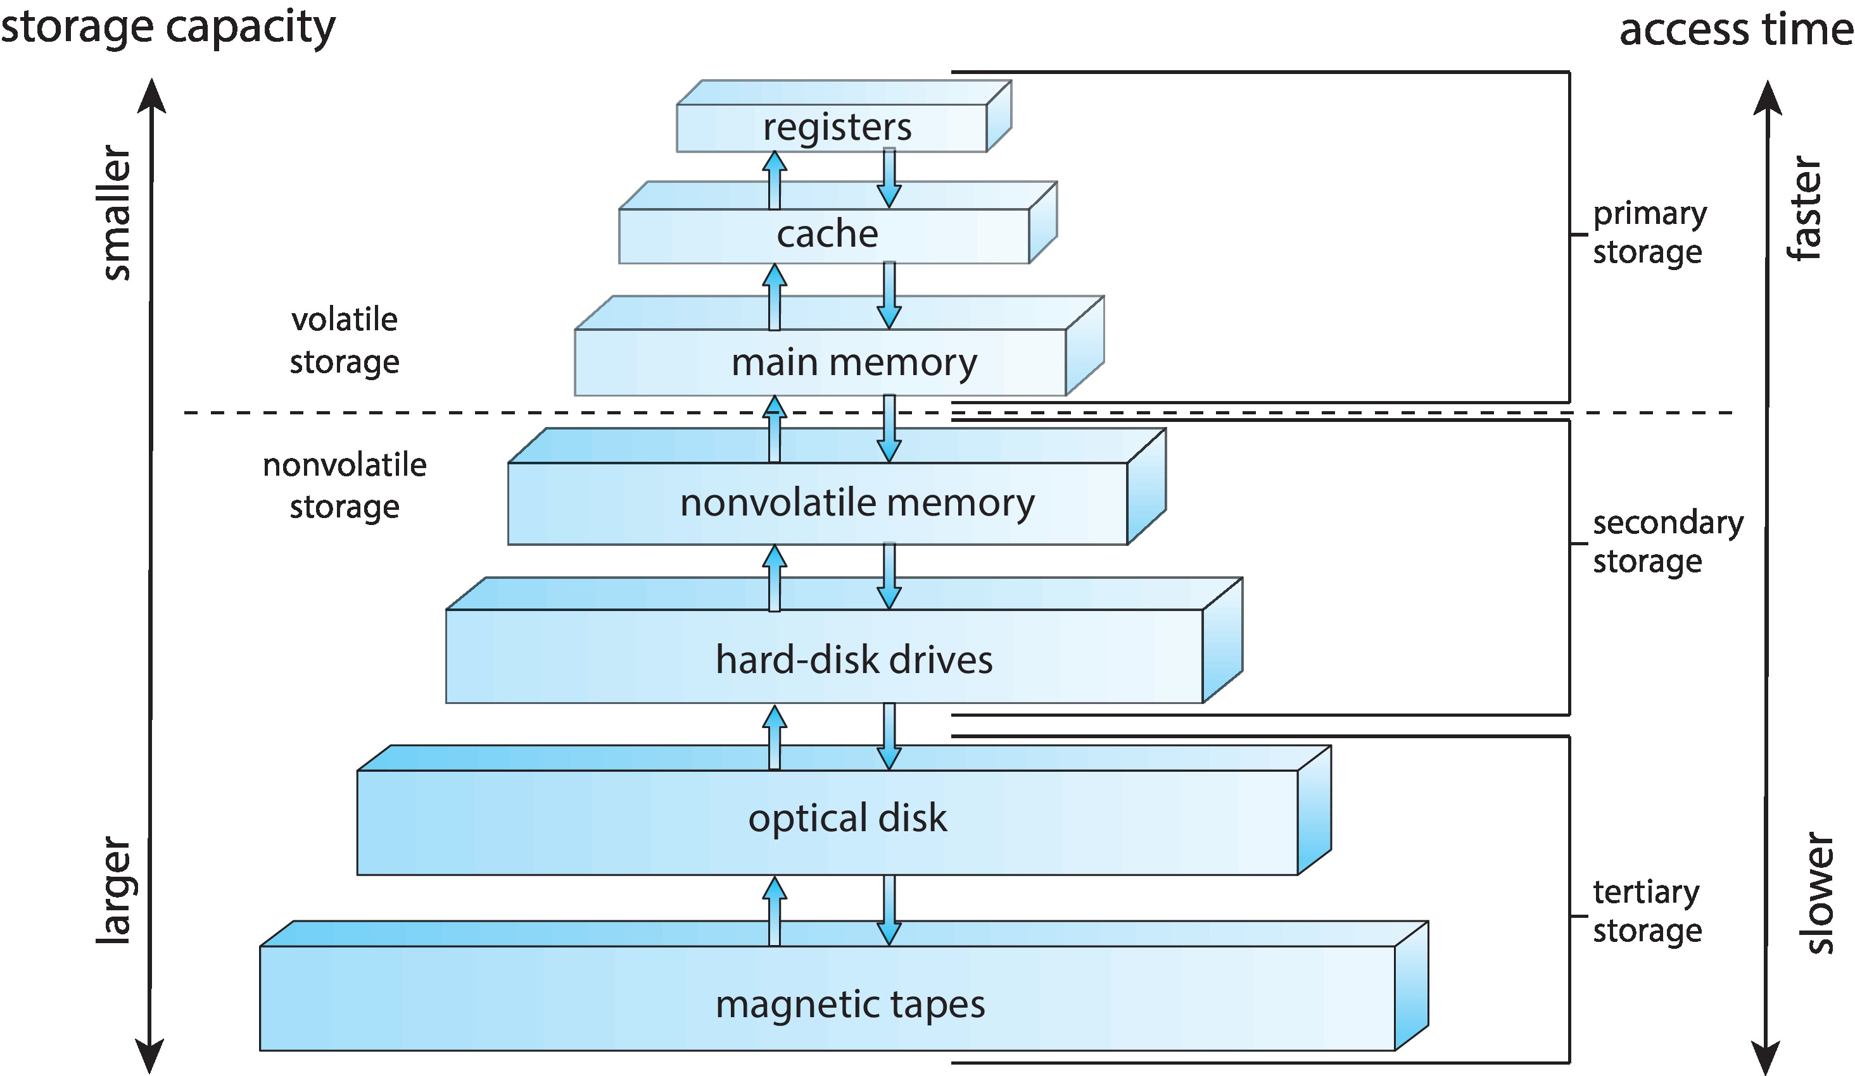
Storage-Device Hierarchy

Slide 24
I/O Operations
How CPU gets a character from the keyboard?
Programmed I/O
Interrupted I/O
Direct Memory Access (DMA)

Slide 25
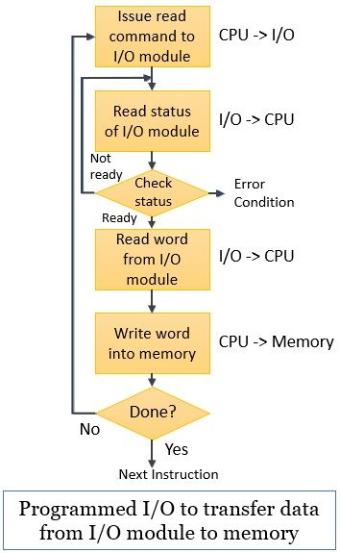
Programmed I/O
How CPU gets a character from the keyboard?
Programmed I/O: a technique that we use to transfer data between the processor and the I/O module.
Regulated with the help of a program.
What’s the greatest drawback of programmed I/O?
a processor keeps on checking whether the I/O module is ready for reception and transmission of data or whether the I/O module has completed the desired task or not. This long waiting of the processor deteriorates the performance of the system.
Notes:
Consider the situation that the processor is busy executing any program. Meanwhile, it encounters an I/O instruction. To execute the encountered instruction the processor issues an appropriate I/O command to the corresponding I/O module
Accepting the issued command, the I/O module performs the desired task and sets some appropriate bits of its I/O status registers
Further, the I/O module does not notify the processor that it has performed the desired task. Moreover, it’s the processors’ responsibility to periodically check the status of the I/O module till it finds that the I/O has successfully completed the desired task.

Slide 26
Programmed I/O
Programmed I/O:
The I/O module does not notify the processor that it has performed the desired task. Moreover, it’s the processors’ responsibility to periodically check the status of the I/O module till it finds that the I/O has successfully completed the desired task.

Slide 27
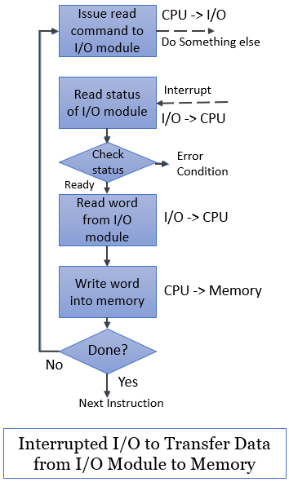
Interrupted I/O
Interrupted I/O: an approach to transfer data between ‘memory’ and ‘I/O devices’ through the ‘processor’
Involves the use of interrupt to exchange data between I/O and memory.
Main idea: after issuing the I/O command to the I/O module the processor can get itself busy doing some other work
Issues an interrupt signal to the processor when I/O has been performed
Notes:
The processor issues a READ I/O command to the corresponding I/O module and proceeds with some other useful tasks. It does not wait for the I/O module to get ready with the desired data.
The I/O module then processes this READ I/O command and reads the data from the addressed peripheral device. The I/O module stores the read data into its data register and issues an interrupt signal to the processor over the control line in the system bus. By sending the interrupted signal, the I/O module indicates the processor that now it is ready for transmitting the data. But, the I/O module has to wait until the processor asks for the data from the I/O module.
As we know that whenever the processor is executing any program, after every instruction cycle it checks for interrupts that have occurred. If it finds the pending interrupts, it responds and serves the occurred interrupt.
The moment processor finds the interrupts by the I/O module, it suspends its current execution and saves the context (e.g., program counter, processor register) to serve the interrupt.
When the processor requests the data from the I/O, it places the data over the data line of the system bus. Once the I/O module transfers the data to the processor it set itself ready for another I/O transfer.
Now processor request data from the I/O module and accept the word of data over the data line. The processor stores this data onto the memory and restores the context of the program it was working on and resumes its execution.

Slide 28
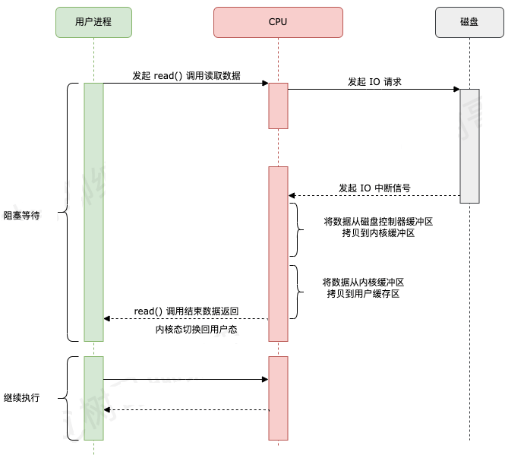
Interrupted I/O
用户进程向 CPU 发起 read 系统调用读取数据，由用户态切换为内核态，然后一直阻塞等待数据的返回。
CPU 在接收到指令以后对磁盘发起 I/O 请求，将磁盘数据先放入磁盘控制器缓冲区。
数据准备完成以后，磁盘向 CPU 发起 I/O 中断。
CPU 收到 I/O 中断以后将磁盘缓冲区中的数据拷贝到内核缓冲区，然后再从内核缓冲区拷贝到用户缓冲区。
用户进程由内核态切换回用户态，解除阻塞状态，然后等待 CPU 的下一个执行时间钟。

Slide 29
Programmed I/O V.S. Interrupted I/O
Programmed I/O：程序直接控制方式就是CPU告诉外设“我要读了”，然后外设开始准备。CPU这时候停下手中的工作，不停的问外设“好了没有”，一旦外设说“好了”，CPU就从外设读一个字，再往内存写一个字，然后再告诉外设“我要继续读”，就这么重复直到完成。所以在读的过程中CPU别的什么也干不了。
Interrupted I/O：CPU告诉外设“我要读了”，然后就不管了，继续干自己的事。这时候外设开始准备，等准备好了就主动告诉CPU“我好了”，CPU这时候停下手里的工作开始从外设读一个字，然后往内存写一个字。写完了就告诉外设“我要继续读”，说完了就继续干刚才被打断前的事，等外设再准备好以后再通知CPU，直到完成。中断方式的好处就是CPU在外设准备的时候不用不停地问，可以做自己的事，提高了利用率。

Slide 30
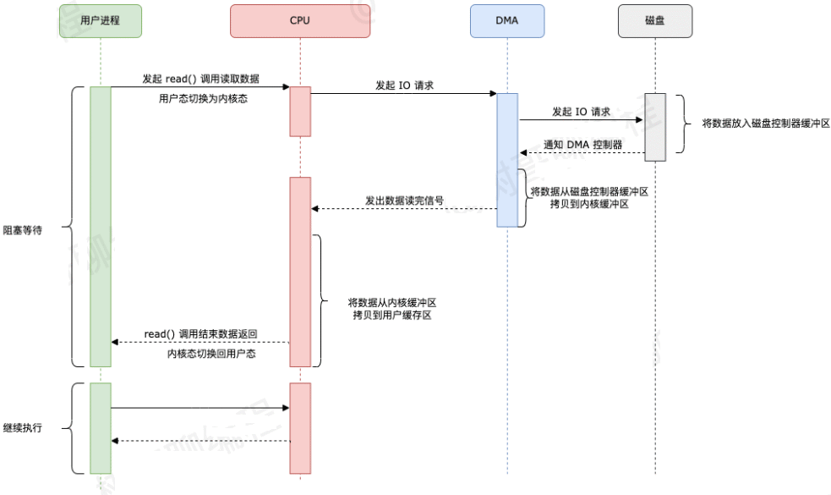
Direct Memory Access (DMA)
Direct Memory Access (DMA) : transfers the data between memory and I/O devices without the intervention of the CPU.
DMA 技术优化了数据从磁盘缓冲区拷贝到内核缓冲区这个过程，减少了这个过程里 CPU 的参与。
Notes:
用户进程向 CPU 发起 read 系统调用读取数据，由用户态切换为内核态，然后一直阻塞等待数据的返回。
CPU 在接收到指令以后对 DMA 磁盘控制器发起调度指令。
DMA 磁盘控制器对磁盘发起 I/O 请求，将磁盘数据先放入磁盘控制器缓冲区，CPU 全程不参与此过程。
数据读取完成后，DMA 磁盘控制器会接受到磁盘的通知，将数据从磁盘控制器缓冲区拷贝到内核缓冲区。
DMA 磁盘控制器向 CPU 发出数据读完的信号，由 CPU 负责将数据从内核缓冲区拷贝到用户缓冲区。
用户进程由内核态切换回用户态，解除阻塞状态，然后等待 CPU 的下一个执行时间钟。
仔细对比加入 DMA 技术之后的数据传输流程，我们可以发现 DMA 技术优化了数据从磁盘缓冲区拷贝到内核缓冲区这个过程，减少了这个过程里 CPU 的参与。

Slide 31
Direct Memory Access (DMA)
DMA方式：CPU告诉DMA“你把XXX个字的内容写到内存的XXX位置去吧”，然后就不管了，等外设准备好了就通知CPU“我准备好了”，然后CPU让出一个节拍的总线使用权，外设就可以直接把数据送入内存，然后再通知CPU说“我传完了”，然后CPU进行一些清理工作就可以了。DMA比中断方式又有提高，因为中断方式中，数据从外设输入内存依然要CPU参与，而DMA在大量数据读入的时候不需要CPU参与，这就节约了CPU的时间。
DMA就是相当于有一个处理器专门来管数据传送，只要CPU把指令告诉DMA，DMA就可以完成一切数据传输任务，所以CPU的利用率更高。

Slide 32
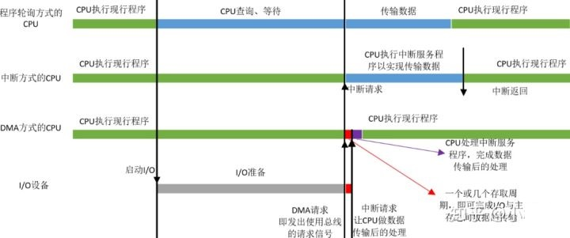
Direct Memory Access (DMA)
当I/O准备就绪，设备向CPU发出DMA请求，CPU响应请求，关闭对主存的控制器，只关闭一个或者几个存取周期，在这一小段时间内，主存和设备完成数据交换。
而且在这一小段时间内，CPU并不是什么都不能做，虽然CPU不能访问主存，即不能取指令，但是CPU的cache中已经保存了一些指令，CPU可以先执行这些指令，只要这些指令不涉及访存，CPU和设备还是并行执行。
数据传输完成后，DMA接口向CPU发出中断请求，让CPU做后续处理。

Slide 33
Quiz
系统将数据从磁盘读到内存的过程包括以下操作：
① DMA控制器发出中断请求
② 初始化DMA控制器并启动磁盘
③ 从磁盘传输一块数据到内存缓冲区
④ 执行“DMA结束”中断服务程序
正确的执行顺序是（ ）。
A. ③→①→②→④
B. ②→③→①→④
C. ②→①→③→④
D. ①→②→④→③
B
2017年全国统考真题，第32题
Notes:
正确的执行顺序是 B. ②→③→①→④。
解释如下：② 初始化DMA控制器并启动磁盘：首先需要初始化DMA控制器，设置好相关参数，之后启动磁盘进行数据传输。③ 从磁盘传输一块数据到内存缓冲区：磁盘开始向内存传输数据。① DMA控制器发出中断请求：当DMA传输完成一块数据时，DMA控制器会向CPU发出中断请求，提示数据传输完成。④ 执行“DMA结束”中断服务程序：CPU响应中断请求并执行“DMA结束”中断服务程序，完成数据传输操作。

Slide 34
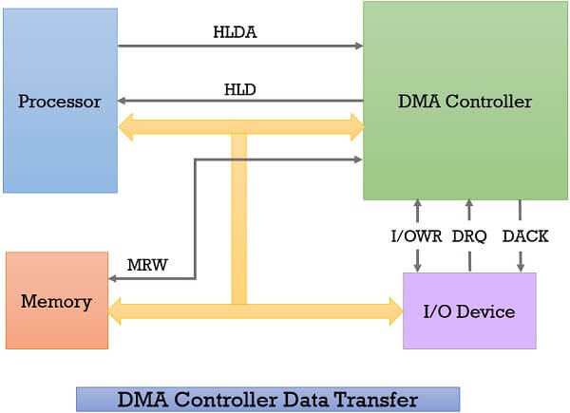
Direct Memory Access (DMA)
Whenever an I/O device wants to transfer the data to or from memory, it sends the DMA request (DRQ) to the DMA controller. DMA controller accepts this DRQ and asks the CPU to hold for a few clock cycles by sending it the Hold request (HLD).
CPU receives the Hold request (HLD) from DMA controller and relinquishes the bus and sends the Hold acknowledgement (HLDA) to DMA controller.
After receiving the Hold acknowledgement (HLDA), DMA controller acknowledges I/O device (DACK) that the data transfer can be performed, and DMA controller takes the charge of the system bus and transfers the data to or from memory.
When the data transfer is accomplished, the DMA raise an interrupt to let the processor know that the task of data transfer is finished and the processor can take control over the bus again and start processing where it has left.

Slide 35
Direct Memory Access (DMA)
Device controller transfers blocks of data from buffer storage directly to main memory without CPU intervention
Only one interrupt is generated per block, rather than the one interrupt per byte
Used for high-speed I/O devices able to transmit information at close to memory speeds
Why Only One Byte (or Word) per Interrupt for programmed I/O or Interrupted I/O?

Slide 36
Question
Why Only One Byte (or Word) per Interrupt for programmed I/O or Interrupted I/O?
The hardware interface typically provides a single data register for the device, and once that register is ready or full, the CPU is either signaled (interrupt) or must explicitly check (polled) to move just that one byte.
Each byte arrival triggers an interrupt, and the CPU must move that byte out of the device register before another arrives.
There is no automated mechanism (like DMA) to transfer larger blocks without CPU intervention, hence you effectively get “one byte per interrupt.”

Slide 37
Direct Memory Access (DMA)
The DMA controller transfers the data in three modes:
Burst Mode: Here, once the DMA controller gains the charge of the system bus, then it releases the system bus only after completion of data transfer. Till then the CPU has to wait for the system buses.
Cycle Stealing Mode: In this mode, the DMA controller forces the CPU to stop its operation and relinquish the control over the bus for a short term to DMA controller. After the transfer of every byte, the DMA controller releases the bus and then again requests for the system bus. In this way, the DMA controller steals the clock cycle for transferring every byte.
Transparent Mode: Here, the DMA controller takes the charge of system bus only if the processor does not require the system bus.

Slide 38
Direct Memory Access (DMA)
Direct Memory Access Advantages and Disadvantages
Advantages:
Transferring the data without the involvement of the processor will speed up the read-write task.
DMA reduces the clock cycle requires to read or write a block of data.
Implementing DMA also reduces the overhead of the processor.
Disadvantages
As it is a hardware unit, it would cost to implement a DMA controller in the system.

Slide 39
Quiz
若设备采用周期挪用DMA方式进行输入和输出，每次 DMA 传送的数据块大小为512 字节，相应的I/O 接口中有一个32位数数据缓冲寄存器。对于数据输入过程，下列叙述中，错误的是
A.每准备好32位数据，DMA控制器就发出一次总线请求
B.相对于CPU，DMA控制器的总线使用权的优先级更高
C.在整个数据块的传送过程中，CPU不可以访问主存储器
D.数据块传送结束时，会产生"DMA 传送结束"中断请求
C
2020年全国统考真题，第22题
Notes:
错误的叙述是 C. 在整个数据块的传送过程中，CPU不可以访问主存储器。
解释如下：A. 每准备好32位数据，DMA控制器就发出一次总线请求：在周期挪用DMA方式下，每32位数据准备好后，DMA控制器会发出总线请求来传送数据，所以这个说法是正确的。B. 相对于CPU，DMA控制器的总线使用权的优先级更高：在周期挪用DMA模式下，DMA控制器通常具有比CPU更高的总线优先级，因此这个说法也是正确的。C. 在整个数据块的传送过程中，CPU不可以访问主存储器：这一说法是错误的。在周期挪用DMA模式下，DMA控制器每次传送的数据块是以较小的周期为单位进行的，并不会完全阻塞CPU对主存储器的访问。CPU可以在DMA传送的过程中访问主存储器，只是可能会被暂时的总线占用影响访问效率。D. 数据块传送结束时，会产生"DMA 传送结束"中断请求：DMA传输结束时确实会发出“DMA传送结束”的中断请求，通知CPU数据传输完成。因此，C选项是错误的。

Slide 40
Quiz
下列关于中断I/O方式和DMA方式比较的叙述中，错误的是（）
中断I/O方式请求的是CPU处理时间，DMA方式请求的是总线使用权
中断响应发生在一条指令执行结束后，DMA响应发生在一个总线事务完成后
中断I/O方式下数据传送通过软件完成，DMA方式下数据传送由硬件完成
中断I/O方式适用于所有外部设备，DMA方式仅适用于快速外部设备
D
2013全国统考真题，第22题
Notes:
错误的叙述是 "中断I/O方式适用于所有外部设备，DMA方式仅适用于快速外部设备"。解释如下：中断I/O方式适用于所有外部设备：这是真的。中断I/O可以用于各种类型的外部设备，无论设备的速度快慢，只要设备支持中断机制，就可以使用中断I/O方式来传输数据。DMA方式仅适用于快速外部设备：这个说法是错误的。虽然DMA方式通常用于需要大量数据传输的设备（如磁盘、网络接口等），但并不是仅限于“快速”设备。DMA可以用于各种设备，只要设备需要高效的数据传输，并且DMA硬件支持。其他选项分析：中断I/O方式请求的是CPU处理时间，DMA方式请求的是总线使用权：这是真的。中断I/O依赖CPU响应中断进行数据处理，而DMA依赖直接内存访问控制器来管理数据传输，不需要CPU参与数据传送过程。中断响应发生在一条指令执行结束后，DMA响应发生在一个总线事务完成后：这也是真的。中断响应在指令执行完成后由CPU进行处理，而DMA响应是由DMA控制器在总线事务完成时进行的。

Slide 41
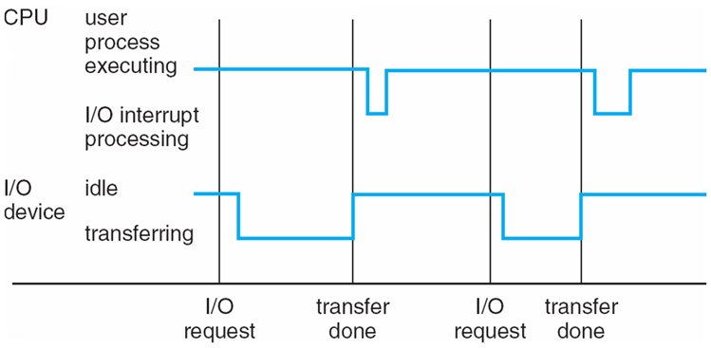
Interrupts
Interrupt driven (hardware and software)
Hardware interrupt by one of the devices
I/O operation is completed
Software interrupt (exception or trap):
Software error (e.g., division by zero)
Invalid memory access
A specific request from user program that an OS service be performed
Events are almost always signaled by the occurrence of an interrupt or a trap
Notes:
A trap is a software-generated interrupt caused either by an error (for example, division by zero or invalid memory access); or by a specific request from user program that an OS service be performed
For example, if a process gets stuck in an infinite loop, this loop could prevent the correct operation of many other processes
More subtle errors can occur in a multiprogramming system, where one erroneous program might modify another program, the data of another program, or even the operating system itself

Slide 42
Quiz
异常是指令执行过程中在处理器内部发生的特殊事件，中断是来自处理器外部的请求事件。下列关于中断或异常情况的叙述中，错误的是
A."访存时缺页"属于中断
B."整数除以0"属于异常
C."DMA传送结束"属干中断
D."存储保护错"属于异常
A

Slide 43
Quiz
"Page fault during memory access" is an interrupt: This statement is incorrect. A "page fault" is an exception, not an interrupt. A page fault occurs when a page in virtual memory is accessed but not currently loaded into physical memory. It is typically handled by the operating system kernel and is an internal processor event, not an external interrupt.
"Division by zero" is an exception: This is correct. "Division by zero" is an arithmetic exception, which is an internal processor exception that usually causes the program to terminate abnormally.
"DMA transfer complete" is an interrupt: This is correct. "DMA transfer complete" is an interrupt triggered by the DMA controller, indicating that the DMA data transfer has finished. It is an external interrupt triggered by a device.
"Storage protection error" is an exception: This is correct. A "storage protection error" occurs when unauthorized memory access (e.g., out-of-bounds access) is attempted, and it is classified as an internal processor exception.Therefore, the incorrect statement is A. "Page fault during memory access" is an interrupt.

Slide 44
Interrupts (Cont.)
Given a specific interrupt, what action should be taken?
Separate segments of code in the operating system determines what action should be taken
An interrupt service routine is provided to deal with the interrupt
Interrupt occur
CPU stops what it is doing
Transfer execution
On completion, CPU resumes
How to find the corresponding interrupt service routine

Slide 45
Interrupts (Cont.)
Interrupt transfers control to the interrupt service routine generally, through the interrupt vector, which contains the addresses of all the service routines
A table of pointers to interrupt routines

Slide 46
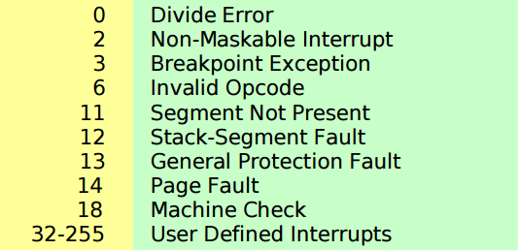
Interrupts (Cont.)
Every interrupt type is assigned a number:
Interrupt vector
A table of pointers to interrupt service routine
When an interrupt occurs, the vector determines what code is invoked to handle the interrupt
Example: vector 14 page fault handler

Slide 47
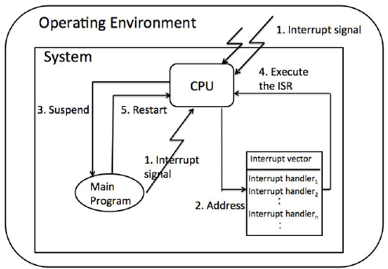
Interrupts (Cont.)
The interrupt must transfer control to the appropriate interrupt service routine
Thus, the interrupt routine is called indirectly through the table

Slide 48
User Mode V.S. Kernel Mode
User mode
Imagine you’re a “guest” in a building with limited access. You can only move around public areas—you don’t have the keys to locked doors, and you can’t access sensitive equipment without permission.
Kernel Mode:
This is like being the “building manager” with master keys. You can open any door, access any room, and control all systems (e.g., electricity, security).
In a computer, user-mode applications (web browsers, games, text editors) operate within strict limits (public areas). They can’t directly operate hardware or system resources. Only kernel-mode code (the OS kernel) can manage low-level access to the CPU, memory, and devices (the locked doors).

Slide 49
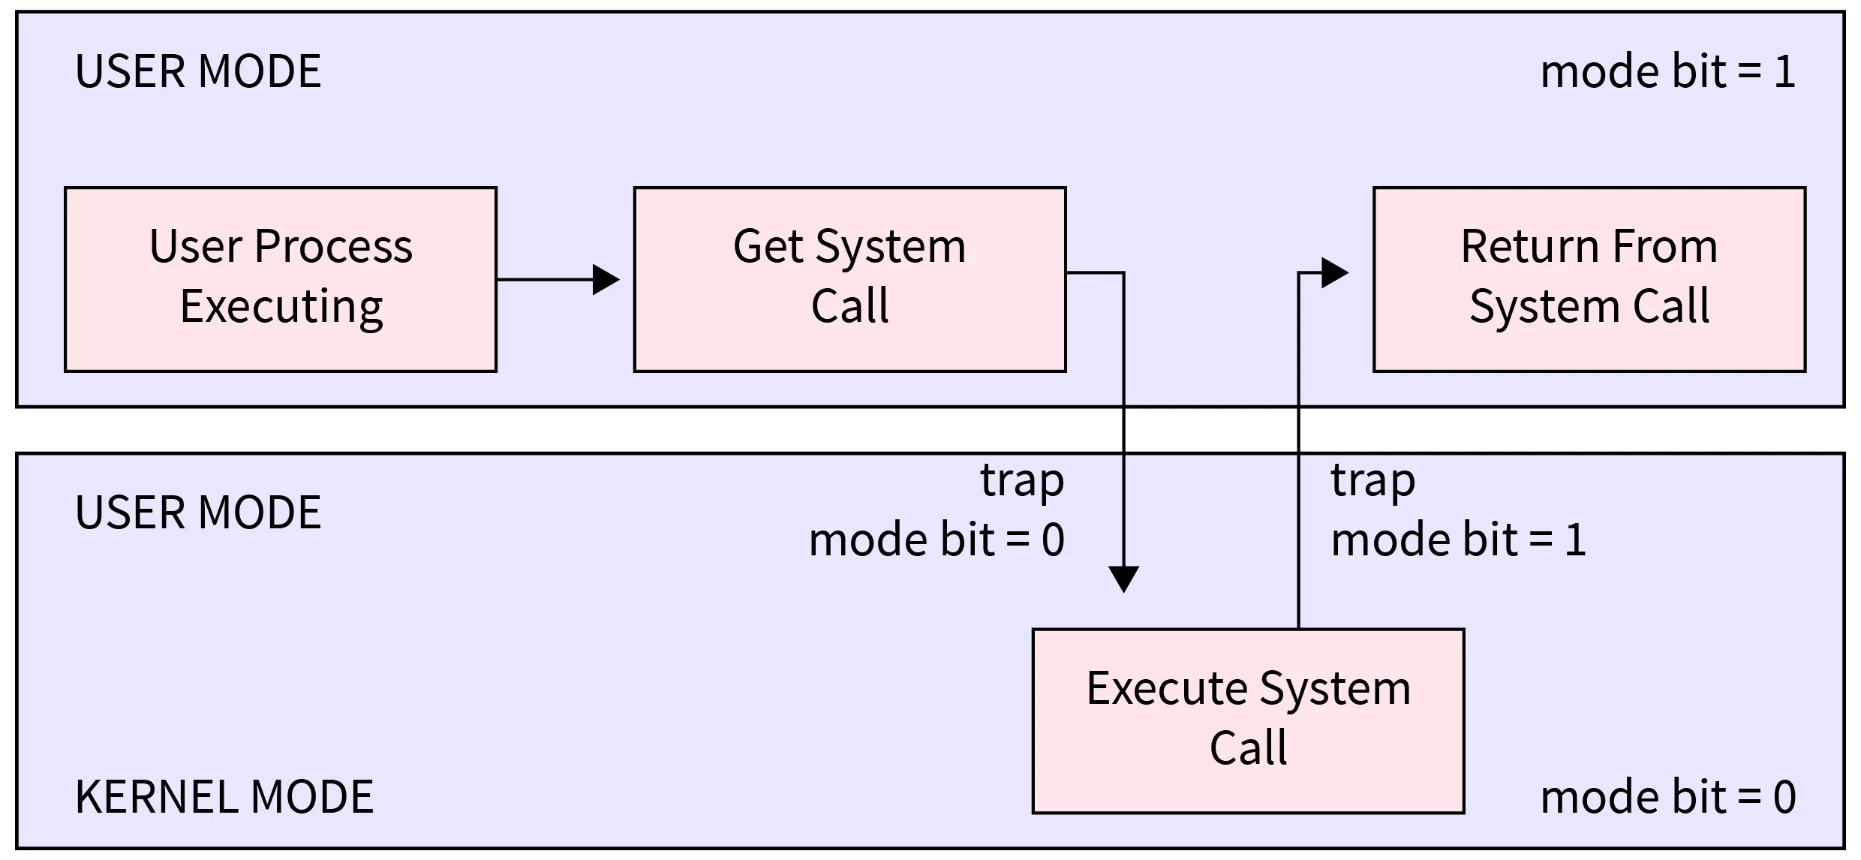
Why the Two Modes?
Security and Stability
By keeping most software in user mode, a programming bug or crash usually just affects that one program.
In kernel mode, mistakes can crash the entire system, because the OS kernel has full control.

Slide 50
Why the Two Modes?
Controlled Access to Hardware
User-mode apps must ask the kernel when they need hardware resources (through system calls).
The kernel checks permissions and decides whether to grant or deny the request.

Slide 51
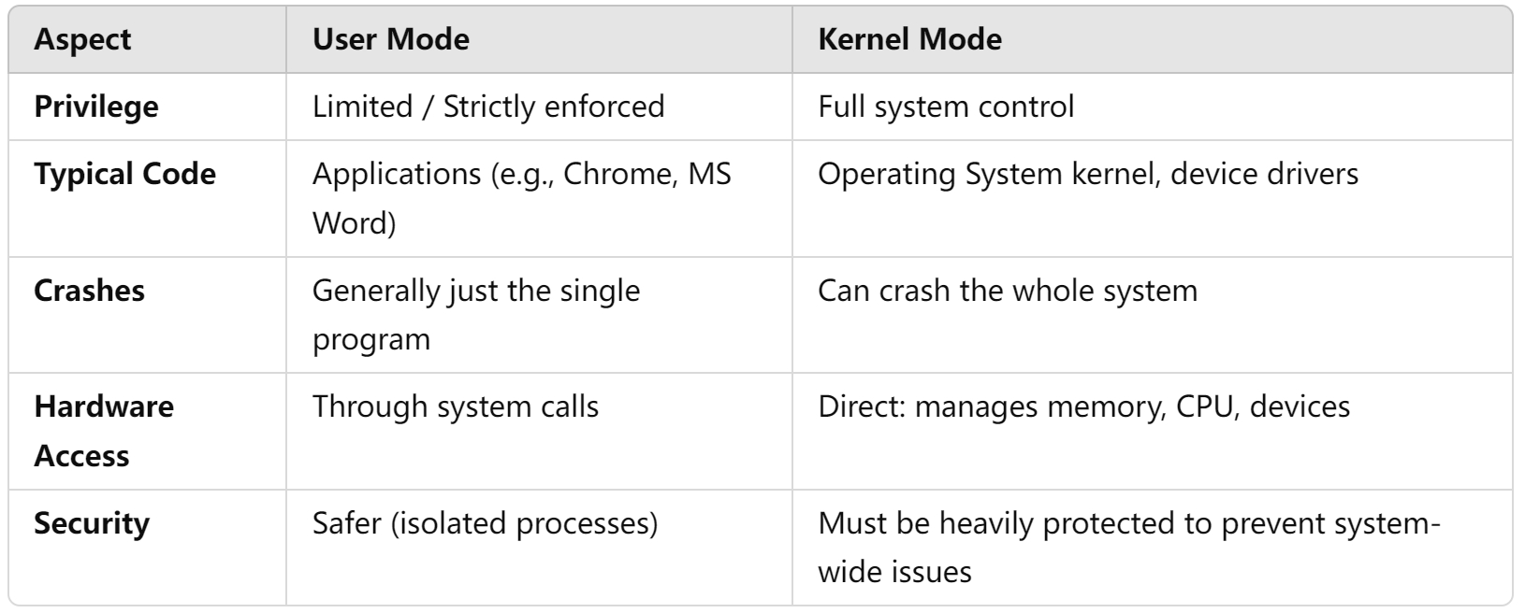
Why the Two Modes?
User mode is like being a guest: safe, controlled, and limited.
Kernel mode is for the operating system itself: powerful but risky if something goes wrong. This split prevents everyday application errors from crashing your whole computer and keeps your system more secure.

Slide 52
Operating-System Operations (cont.)
User mode
Each application's virtual address space is private, one application can't modify another application's data.
Each application runs in isolation
The virtual address space of a user-mode application is also limited.
Kernel mode
All code running in kernel mode shares a single virtual address space.
If a kernel-mode driver mistakenly writes to the wrong virtual address, it could compromise data belonging to the operating system or another driver.
If a kernel-mode driver crashes, it causes the entire operating system to crash.

Slide 53
Operating-System Operations (cont.)
Proper execution: distinguish between the execution of operating-system code and user-defined code
Dual-mode operation allows OS to protect itself and other system components
User mode and kernel mode
Mode bit provided by hardware
Provides ability to distinguish when system is running user code or kernel code
System call changes mode to kernel, return from call resets it to user
Protection operating system
Some instructions designated as privileged, only executable in kernel mode
Notes:
When the computer system is executing on behalf of a user application, the system is in user mode; However, when a user application requests a service from the operating system (via a system call), the system must transition from user to kernel mode to fulfill the request
%%%%%%%%%%%%%%%%%%%
We accomplish this protection by designating some of the machine instructions that may cause harm as privileged instructions
If an attempt is made to execute a privileged instruction in user mode, the hardware does not execute the instruction but rather treats it as illegal and traps it to the operating system

Slide 54
Operating-System Operations (cont.)
Life cycle of instruction execution
Execute user app
Initial:
kernel mode
user mode
Interrupt
System call
Without hardware-supported dual mode (for example, MS-DOS), a user program can wipe out the operating system by writing over it with data; multiple programs are able to write to a device at the same time

Slide 55

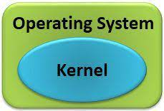
System Call
Request service
e.g.:
open a file
create a process
……
User program
API: open(), fork()
……
System call provides the services of the operating system to the user programs via Application Program Interface (API).
It provides an interface between a process and operating system to allow user-level processes to request services of the operating system.
System calls are the only entry points into the kernel system.

Slide 56
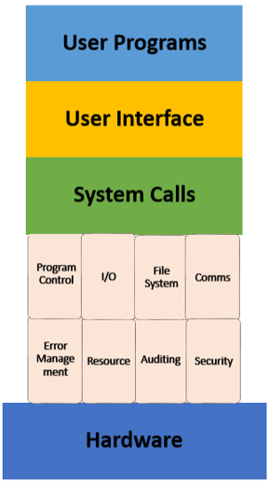

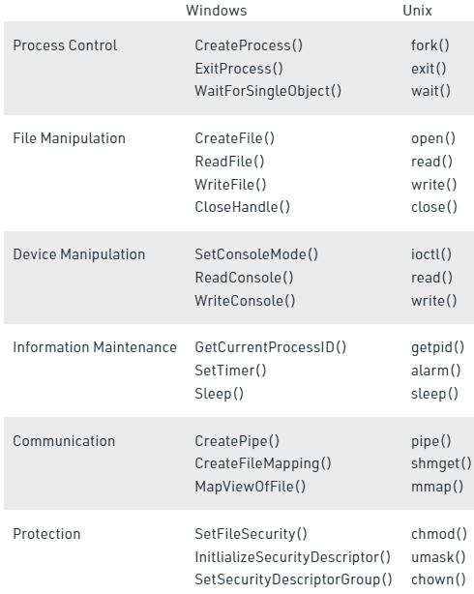
System Call

Slide 57
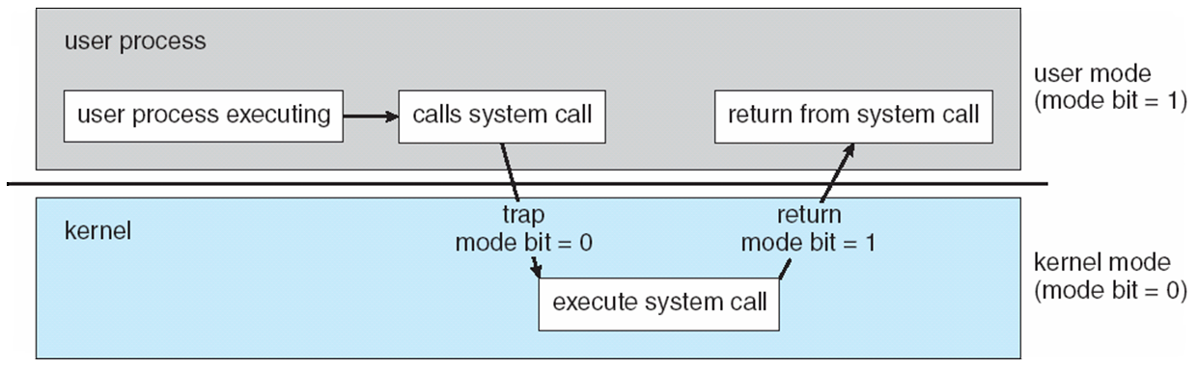
Transition from User to Kernel Mode

Slide 58
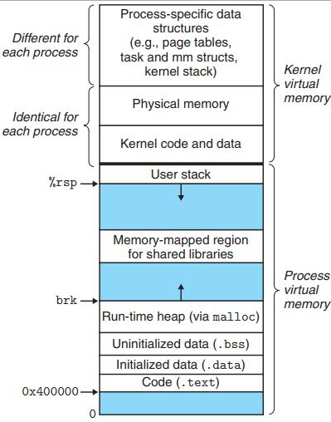
User mode
Because an application's virtual address space is private, one application cannot alter data that belongs to another application
Each application runs in isolation, and if an application crashes, the crash is limited to that one application.
Other applications and the operating system are not affected by the crash.

Slide 59
User mode
In addition to being private, the virtual address space of a user-mode application is limited
A processor running in user mode cannot access virtual addresses that are reserved for the operating system.
Limiting the virtual address space of a user-mode application prevents the application from altering, and possibly damaging, critical operating system data.

Slide 60
Kernel mode
All code that runs in kernel mode shares a single virtual address space.
This means that a kernel-mode driver is not isolated from other drivers and the operating system itself.
If a kernel-mode driver accidentally writes to the wrong virtual address, data that belongs to the operating system or another driver could be compromised.
If a kernel-mode driver crashes, the entire operating system crashes.

Slide 61
Quiz
执行系统调用的过程包括如下主要操作：
①返回用户态
②执行陷入（trap）指令
③传递系统调用参数
④执行相应的服务程序
正确的执行顺序是
A.②—>③—>①—>④
B.②—>④—>③—>①
C.③—>②—>④—>①
D.③—>④—>②—>①
C
2017年全国统考真题，第24题

Slide 62
Multiprogramming (Batch system)
Single user cannot always keep CPU and I/O devices busy
Multiprogramming organizes jobs (code and data) so CPU always has one to execute
A subset of total jobs in system is kept in memory
One job selected and run via job scheduling
When job has to wait (for I/O for example), OS switches to another job

Slide 63
Multitasking (Timesharing)
A logical extension of Batch systems– the CPU switches jobs so frequently that users can interact with each job while it is running, creating interactive computing
Response time should be < 1 second
Each user has at least one program executing in memory  process
If several jobs ready to run at the same time  CPU scheduling
If processes don’t fit in memory, swapping moves them in and out to run
Virtual memory allows execution of processes not completely in memory

Slide 64
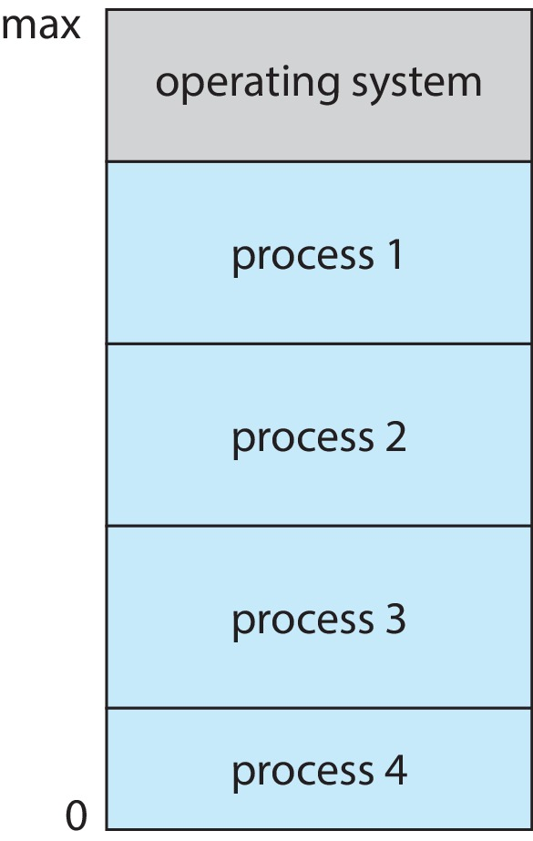
Memory Layout for Multiprogrammed System

Slide 65
Dual-mode Operation
Dual-mode operation allows OS to protect itself and other system components
User mode and kernel mode
Mode bit provided by hardware
Provides ability to distinguish when system is running user code or kernel code.
When a user is running  mode bit is “user”
When kernel code is executing  mode bit is “kernel”
How do we guarantee that user does not explicitly set the mode bit to “kernel”?
System call changes mode to kernel, return from call resets it to user
Some instructions designated as privileged, only executable in kernel mode

Slide 66
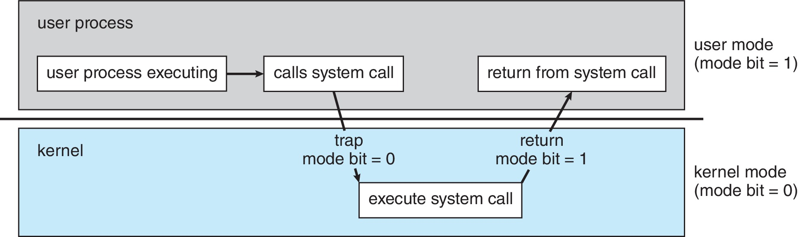
Transition from User to Kernel Mode

Slide 67
Timer
Timer to prevent infinite loop (or process hogging resources)
Timer is set to interrupt the computer after some time period
Keep a counter that is decremented by the physical clock
Operating system set the counter (privileged instruction)
When counter zero generate an interrupt
Set up before scheduling process to regain control or terminate program that exceeds allotted time

Slide 68
Process Management
A process is a program in execution. It is a unit of work within the system. Program is a passive entity; process is an active entity.
Process needs resources to accomplish its task
CPU, memory, I/O, files
Initialization data
Process termination requires reclaim of any reusable resources
Single-threaded process has one program counter specifying location of next instruction to execute
Process executes instructions sequentially, one at a time, until completion
Multi-threaded process has one program counter per thread
Typically system has many processes, some user, some operating system running concurrently on one or more CPUs
Concurrency by multiplexing the CPUs among the processes / threads

Slide 69
Process Management Activities
The operating system is responsible for the following activities in connection with process management:
Creating and deleting both user and system processes
Suspending and resuming processes
Providing mechanisms for process synchronization
Providing mechanisms for process communication
Providing mechanisms for deadlock handling

Slide 70
Memory Management
To execute a program all (or part) of the instructions must be in memory
All (or part) of the data that is needed by the program must be in memory
Memory management determines what is in memory and when
Optimizing CPU utilization and computer response to users
Memory management activities
Keeping track of which parts of memory are currently being used and by whom
Deciding which processes (or parts thereof) and data to move into and out of memory
Allocating and deallocating memory space as needed

Slide 71
File-system Management
OS provides uniform, logical view of information storage
Abstracts physical properties to logical storage unit - file
Each medium is controlled by device (i.e., disk drive, tape drive)
Varying properties include access speed, capacity, data-transfer rate, access method (sequential or random)
File-System management
Files usually organized into directories
Access control on most systems to determine who can access what
OS activities include
Creating and deleting files and directories
Primitives to manipulate files and directories
Mapping files onto secondary storage
Backup files onto stable (non-volatile) storage media

Slide 72
Mass-Storage Management
Usually disks used to store data that does not fit in main memory or data that must be kept for a “long” period of time
Proper management is of central importance
Entire speed of computer operation hinges on disk subsystem and its algorithms
OS activities
Mounting and unmounting
Free-space management
Storage allocation
Disk scheduling
Partitioning
Protection

Slide 73
Caching
Important principle, performed at many levels in a computer (in hardware, operating system, software)
Information in use copied from slower to faster storage temporarily
Faster storage (cache) checked first to determine if information is there
If it is, information used directly from the cache (fast)
If not, data copied to cache and used there
Cache smaller than storage being cached
Cache management important design problem
Cache size and replacement policy

Slide 74
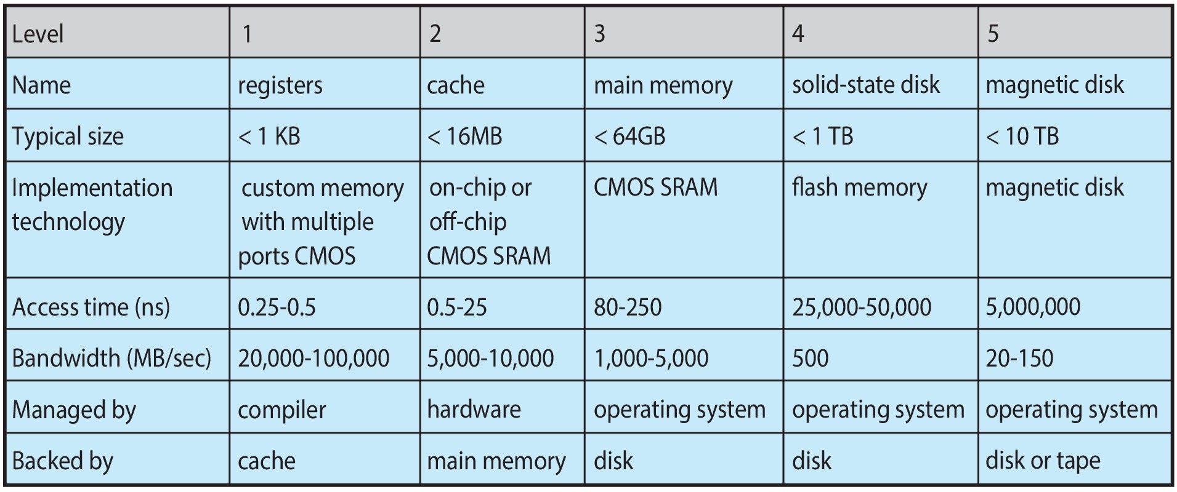
Characteristics of Various Types of Storage
Movement between levels of storage hierarchy can be explicit or implicit

Slide 75
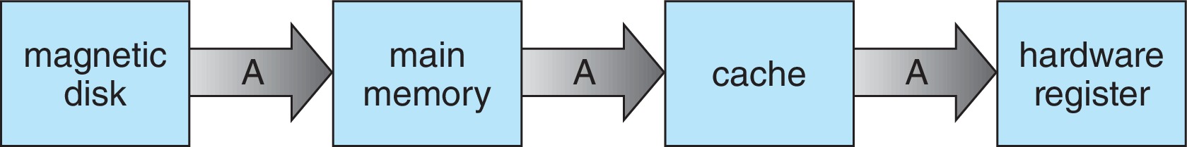
Migration of data “A” from Disk to Register
Multitasking environments must be careful to use most recent value, no matter where it is stored in the storage hierarchy
Multiprocessor environment must provide cache coherency in hardware such that all CPUs have the most recent value in their cache
Distributed environment situation even more complex
Several copies of a datum can exist
Various solutions covered in Chapter 19

Slide 76
I/O Subsystem
One purpose of OS is to hide peculiarities of hardware devices from the user
I/O subsystem responsible for
Memory management of I/O including buffering (storing data temporarily while it is being transferred), caching (storing parts of data in faster storage for performance), spooling (the overlapping of output of one job with input of other jobs)
General device-driver interface
Drivers for specific hardware devices

Slide 77
Protection and Security
Protection – any mechanism for controlling access of processes or users to resources defined by the OS
Security – defense of the system against internal and external attacks
Huge range, including denial-of-service, worms, viruses, identity theft, theft of service
Systems generally first distinguish among users, to determine who can do what
User identities (user IDs, security IDs) include name and associated number, one per user
User ID then associated with all files, processes of that user to determine access control
Group identifier (group ID) allows set of users to be defined and controls managed, then also associated with each process, file
Privilege escalation allows user to change to effective ID with more rights

Slide 78
Virtualization
Allows operating systems to run applications within other OSes
Vast and growing industry
Emulation used when source CPU type different from target type (i.e. PowerPC to Intel x86)
Generally slowest method
When computer language not compiled to native code – Interpretation
Virtualization – OS natively compiled for CPU, running guest OSes also natively compiled
Consider VMware running WinXP guests, each running applications, all on native WinXP host OS
VMM (virtual machine Manager) provides virtualization services

Slide 79
Virtualization (cont.)
Use cases involve laptops and desktops running multiple OSes for exploration or compatibility
Apple laptop running Mac OS X host, Windows as a guest
Developing apps for multiple OSes without having multiple systems
Quality assurance testing applications without having multiple systems
Executing and managing compute environments within data centers
VMM can run natively, in which case they are also the host
There is no general-purpose host then (VMware ESX and Citrix XenServer)

Slide 80
Computing Environments - Virtualization

Slide 81
Quiz

Slide 82
Quiz 1
In which scenario might programmed I/O still be preferred over interrupt-driven I/O?
When the device is extremely high-speed and generates too many interrupts.
When the device is very slow and occasional.
When the device has direct memory access capability.
When the CPU wants to offload data transfer to the device.
Correct Answer: A
Paradoxically, if a device is extremely high-speed and would generate interrupts too frequently, the CPU might spend more overhead handling interrupts than simply polling.
Most textbooks note that interrupt-driven I/O is efficient for moderate/slower devices, while very fast devices might cause interrupt overhead.
(Also, for extremely slow devices, interrupt-driven I/O is still often more efficient, so the best match is A.)

Slide 83
Quiz 2
After a DMA transfer completes a block of data (e.g., 512 bytes from disk to memory), what typically happens next?
The DMA controller automatically starts the next block transfer without notifying the CPU.
The CPU polls the DMA controller to see if the transfer is done.
The DMA controller issues an interrupt to signal the CPU that the transfer has finished.
The DMA controller halts the system until the user acknowledges completion.
Correct Answer: C
Generally, once a DMA transfer completes, the controller sends an interrupt to the CPU (“DMA transfer complete”), so the CPU can continue with the next steps in the I/O process.

Slide 84
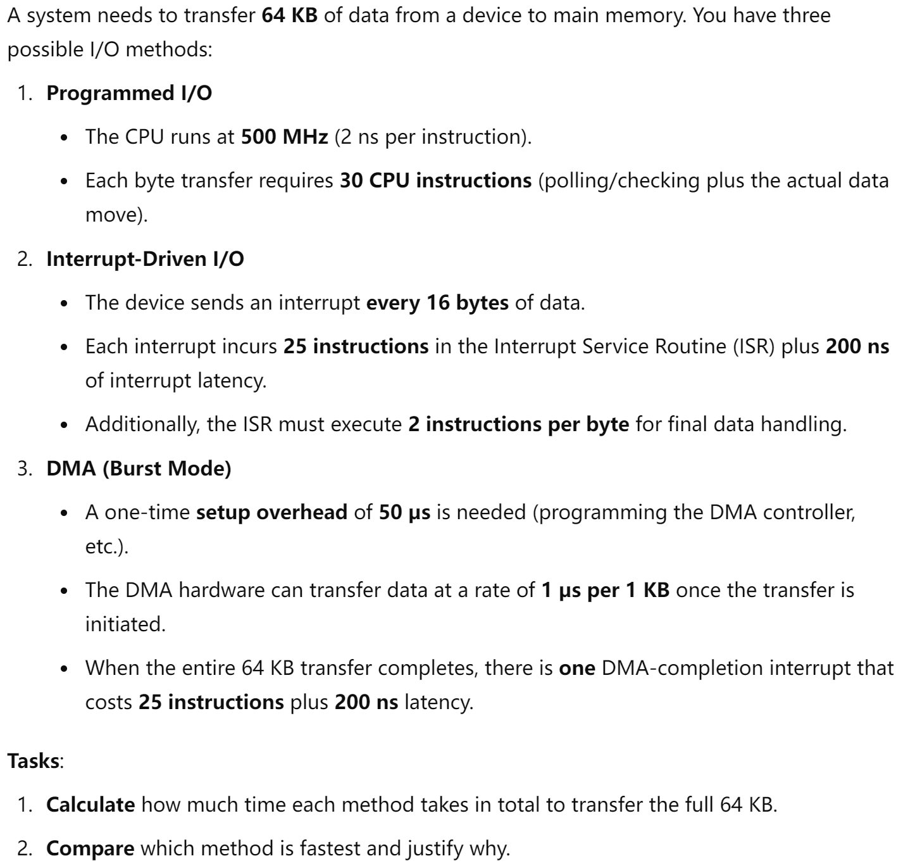
Quiz 3

Slide 85
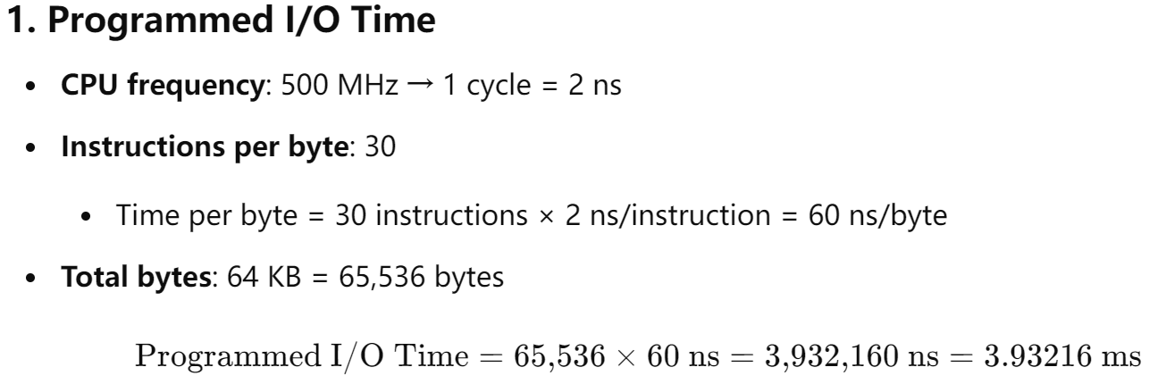
Solution to Quiz 3

Slide 86
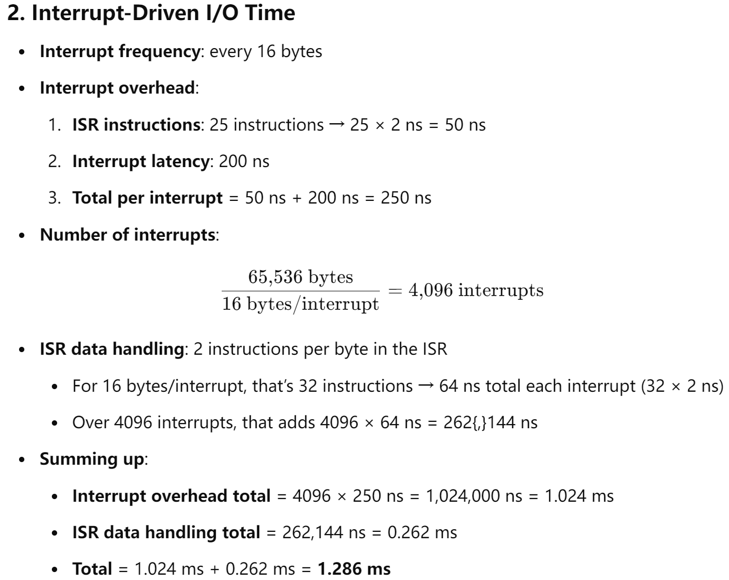
Solution to Quiz 3

Slide 87
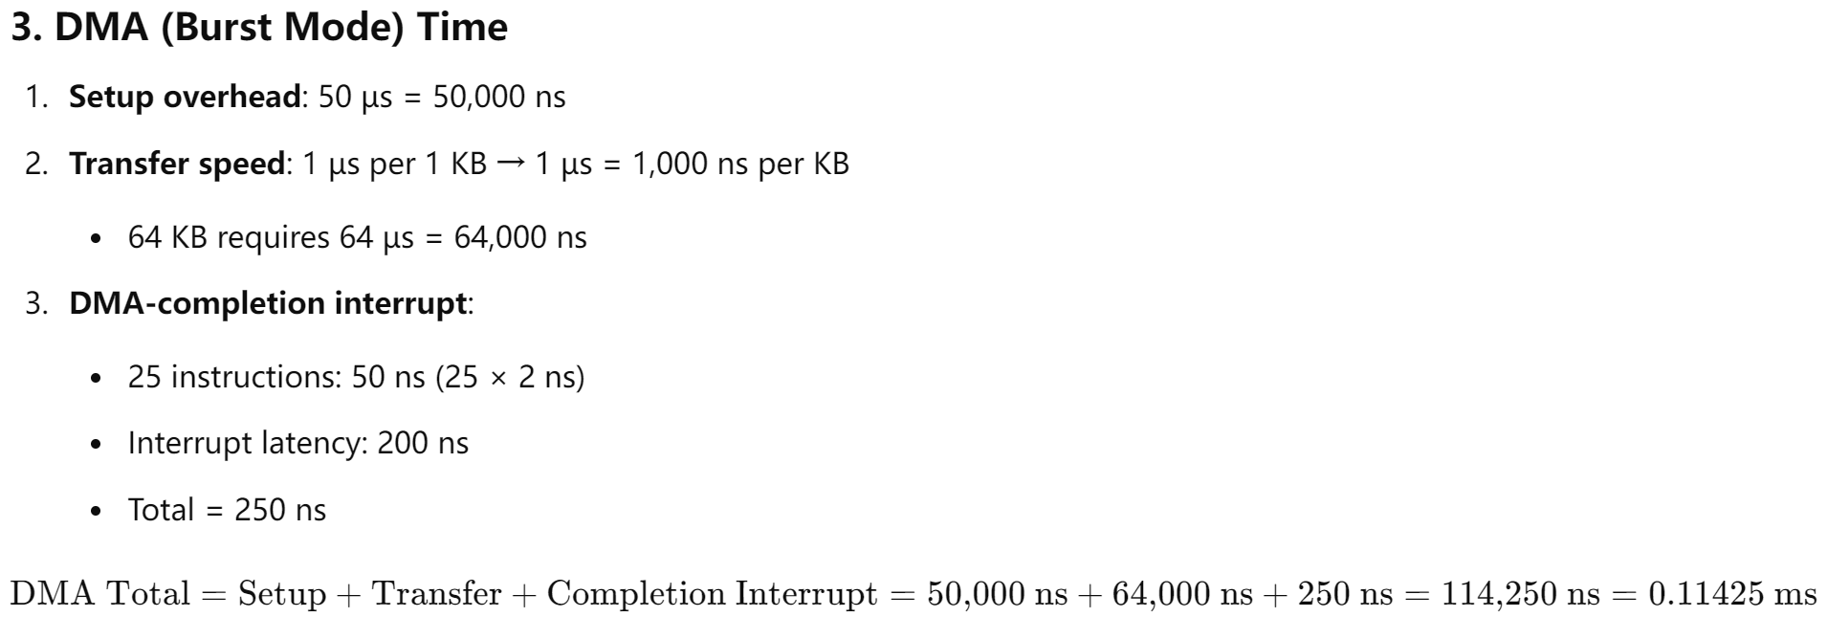
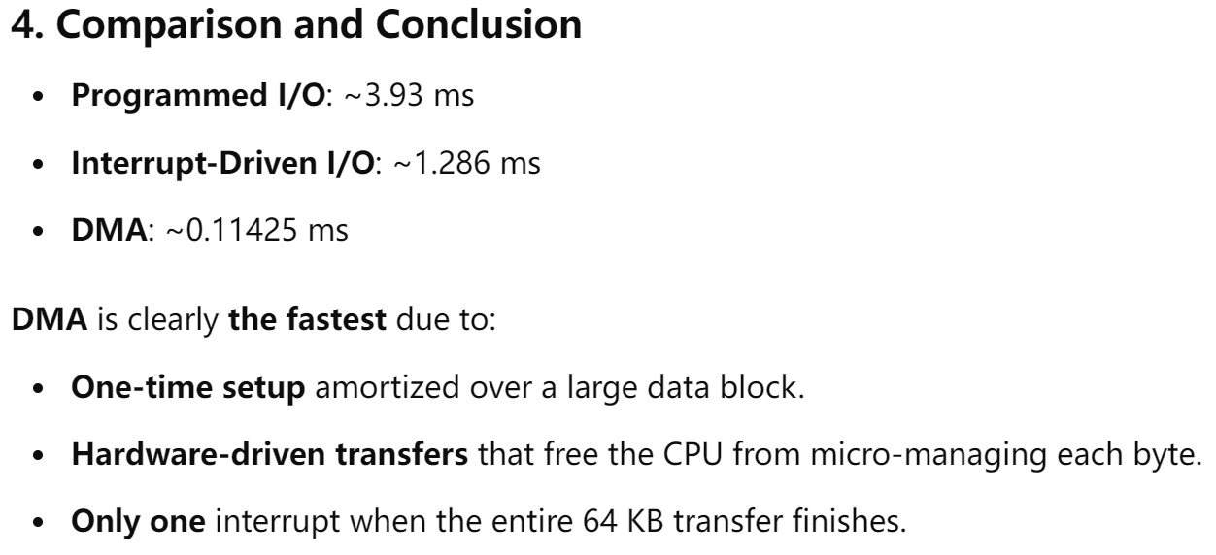
Solution to Quiz 3

Slide 88
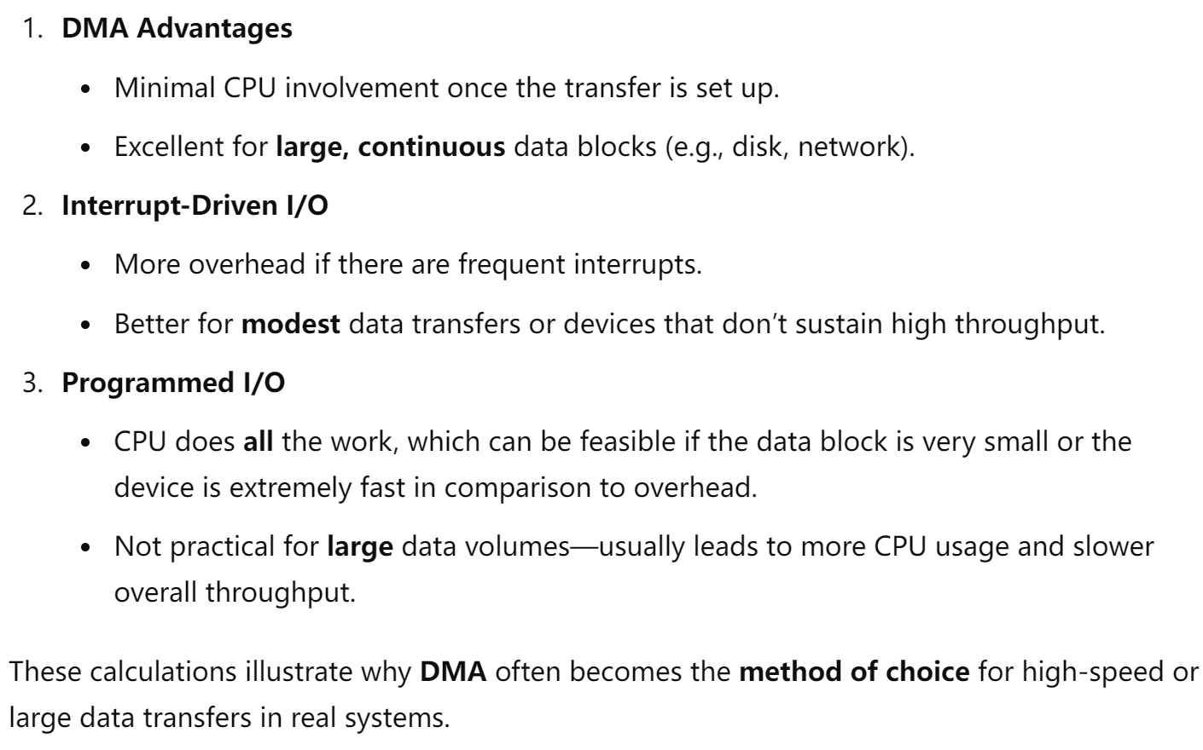
Solution to Quiz 3

Slide 89
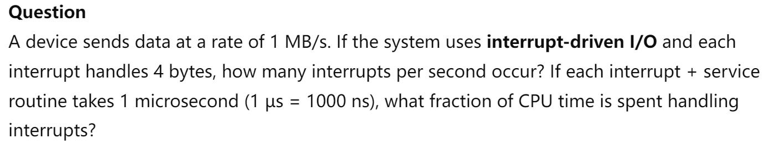
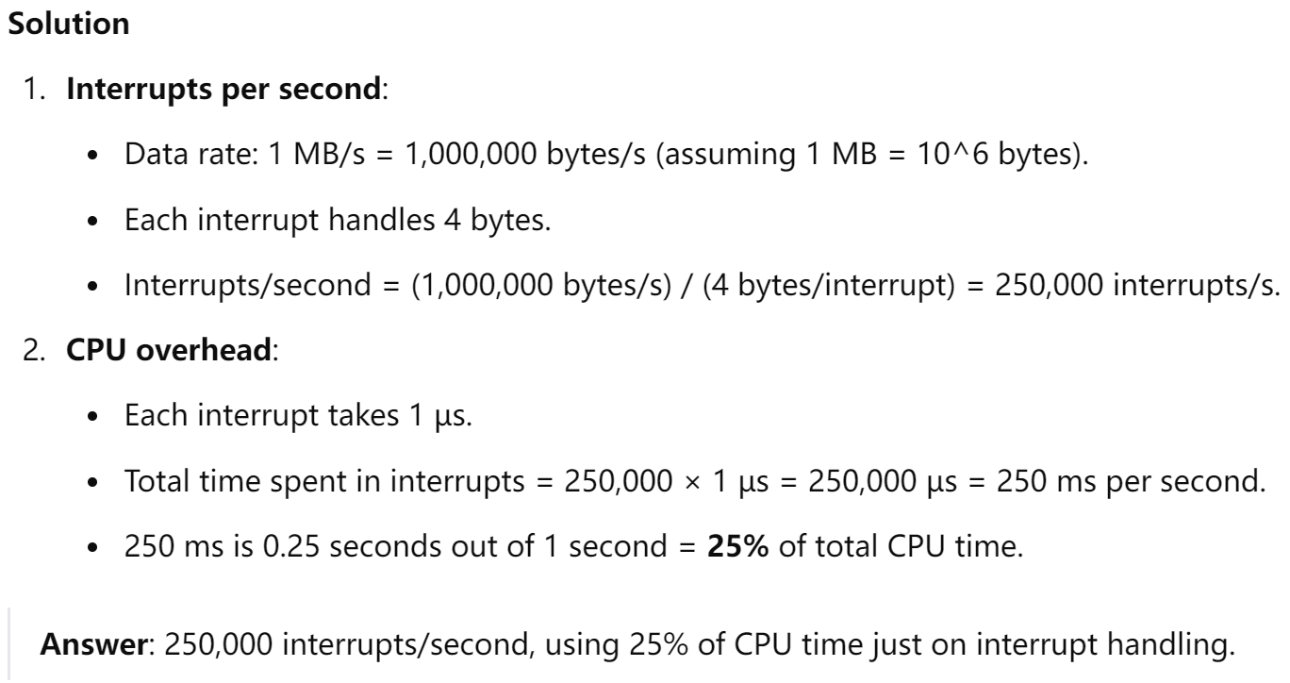
Quiz 4

Slide 90
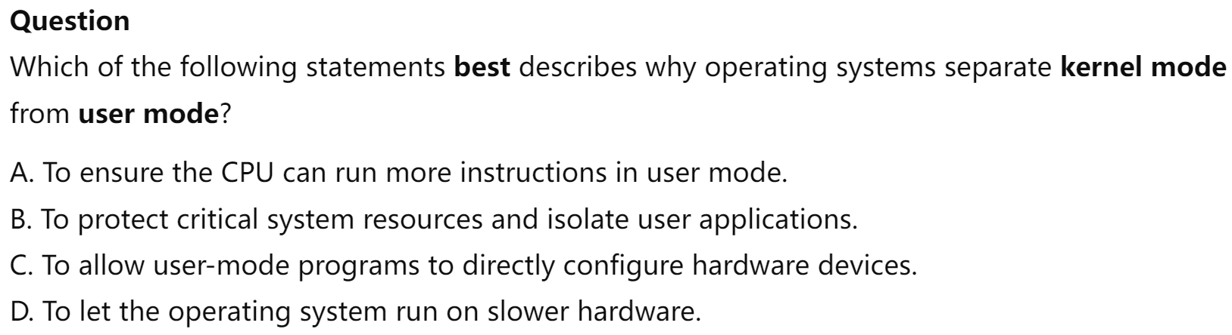
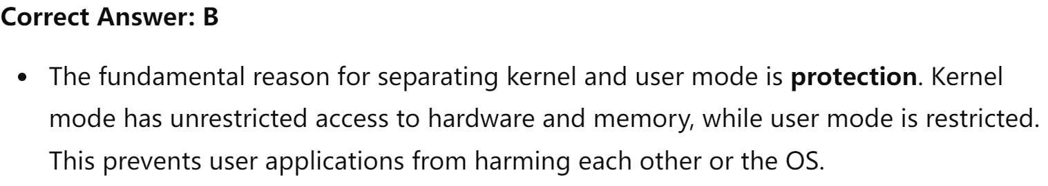
Quiz 5

Slide 91
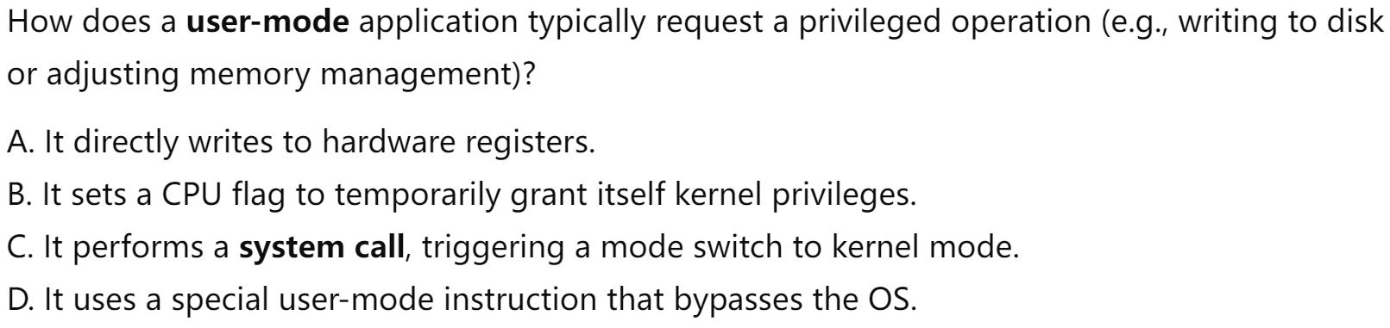
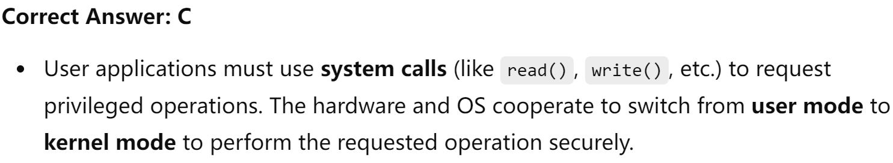
Quiz 6

Slide 92
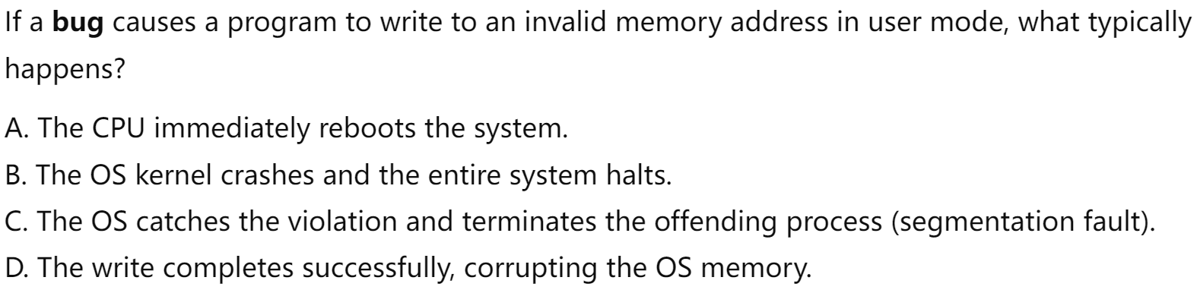
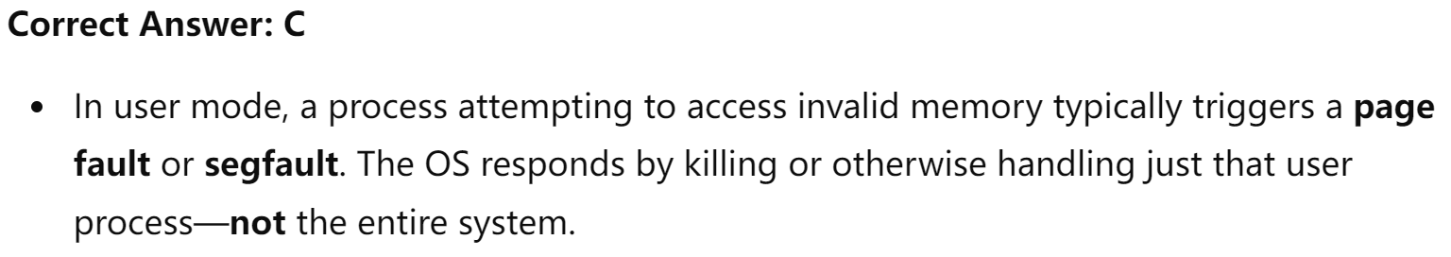
Quiz 7

Slide 93
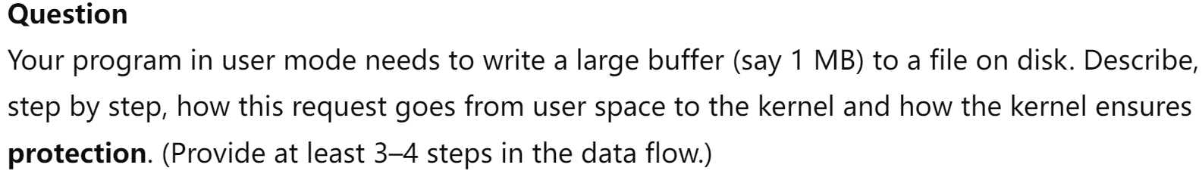
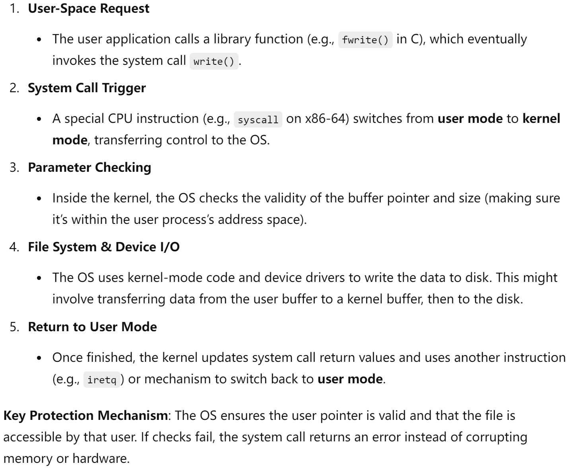
Quiz 8

Slide 94
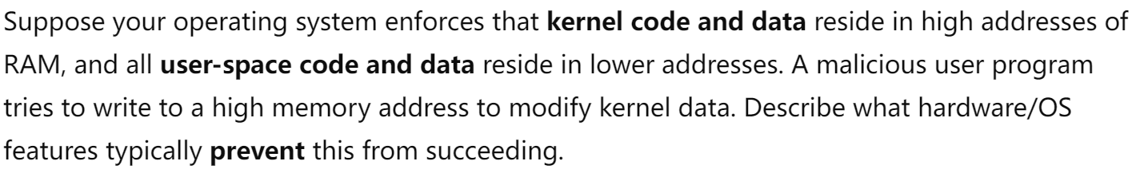
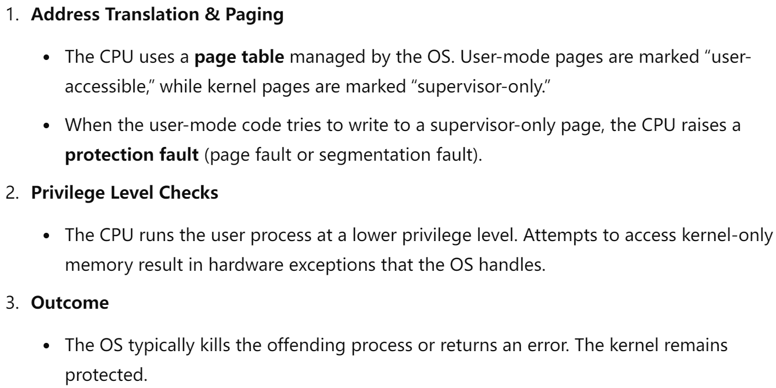
Quiz 8

Slide 95
Distributed Systems
Collection of separate, possibly heterogeneous, systems networked together
Network is a communications path, TCP/IP most common
Local Area Network (LAN)
Wide Area Network (WAN)
Metropolitan Area Network (MAN)
Personal Area Network (PAN)
Network Operating System provides features between systems across network
Communication scheme allows systems to exchange messages
Illusion of a single system

Slide 96
Computer System Architecture

Slide 97
Computer-System Architecture
Most systems use a single general-purpose processor
Most systems have special-purpose processors as well
Multiprocessors systems growing in use and importance
Also known as parallel systems, tightly-coupled systems
Advantages include:
Increased throughput
Economy of scale
Increased reliability – graceful degradation or fault tolerance
Two types:
Asymmetric Multiprocessing – each processor is assigned a specie task.
Symmetric Multiprocessing – each processor performs all tasks

Slide 98
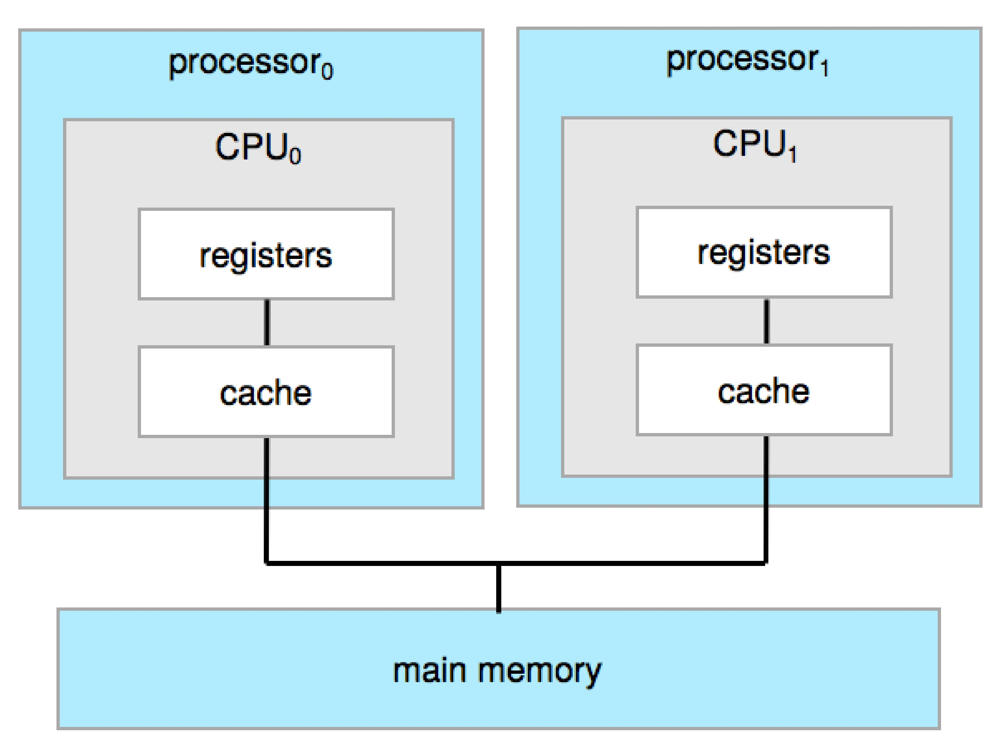
Symmetric Multiprocessing Architecture

Slide 99
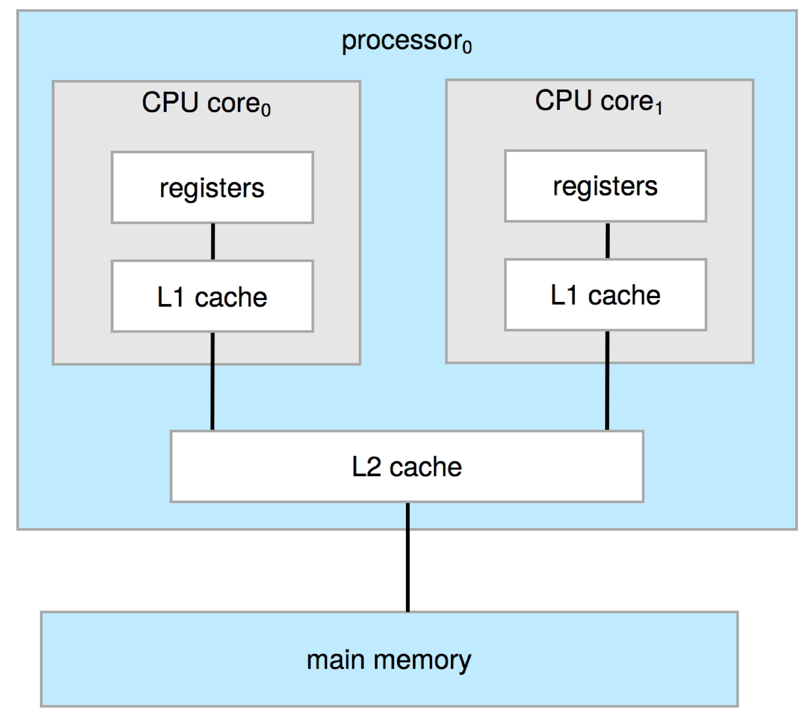
Dual-Core Design
Multi-chip and multicore
Systems containing all chips
Chassis containing multiple separate systems

Slide 100

Non-Uniform Memory Access System

Slide 101
Clustered Systems
Like multiprocessor systems, but multiple systems working together
Usually sharing storage via a storage-area network (SAN)
Provides a high-availability service which survives failures
Asymmetric clustering has one machine in hot-standby mode
Symmetric clustering has multiple nodes running applications, monitoring each other
Some clusters are for high-performance computing (HPC)
Applications must be written to use parallelization
Some have distributed lock manager (DLM) to avoid conflicting operations

Slide 102

Clustered Systems

Slide 103

PC Motherboard

Slide 104
Computer System Environments

Slide 105
Computing Environments
Traditional
Mobile
Client Server
Peer-to-Peer
Cloud computing
Real-time Embedded

Slide 106
Traditional
Stand-alone general-purpose machines
But blurred as most systems interconnect with others (i.e., the Internet)
Portals provide web access to internal systems
Network computers (thin clients) are like Web terminals
Mobile computers interconnect via wireless networks
Networking becoming ubiquitous – even home systems use firewalls to protect home computers from Internet attacks

Slide 107
Mobile
Handheld smartphones, tablets, etc.
What is the functional difference between them and a “traditional” laptop?
Extra feature – more OS features (GPS, gyroscope)
Allows new types of apps like augmented reality
Use IEEE 802.11 wireless, or cellular data networks for connectivity
Leaders are Apple iOS and Google Android

Slide 108
Client Server
Client-Server Computing
Dumb terminals supplanted by smart PCs
Many systems now servers, responding to requests generated by clients
Compute-server system provides an interface to client to request services (i.e., database)
File-server system provides interface for clients to store and retrieve files

Slide 109
Peer-to-Peer
Another model of distributed system
P2P does not distinguish clients and servers
Instead all nodes are considered peers
May each act as client, server or both
Node must join P2P network
Registers its service with central lookup service on network, or
Broadcast request for service and respond to requests for service via discovery protocol
Examples include Napster and Gnutella, Voice over IP (VoIP) such as Skype

Slide 110
Cloud Computing
Delivers computing, storage, even apps as a service across a network
Logical extension of virtualization because it uses virtualization as the base for it functionality.
Amazon EC2 has thousands of servers, millions of virtual machines, petabytes of storage available across the Internet, pay based on usage

Slide 111
Cloud Computing (Cont.)
Many types
Public cloud – available via Internet to anyone willing to pay
Private cloud – run by a company for the company’s own use
Hybrid cloud – includes both public and private cloud components
Software as a Service (SaaS) – one or more applications available via the Internet (i.e., word processor)
Platform as a Service (PaaS) – software stack ready for application use via the Internet (i.e., a database server)
Infrastructure as a Service (IaaS) – servers or storage available over Internet (i.e., storage available for backup use)

Slide 112
Cloud Computing (cont.)
Cloud computing environments composed of traditional OSes, plus VMMs, plus cloud management tools
Internet connectivity requires security like firewalls
Load balancers spread traffic across multiple applications

Slide 113
Real-Time Embedded Systems
Real-time embedded systems most prevalent form of computers
Vary considerable, special purpose, limited purpose OS, real-time OS
Use expanding
Many other special computing environments as well
Some have OSes, some perform tasks without an OS
Real-time OS has well-defined fixed time constraints
Processing must be done within constraint
Correct operation only if constraints met

Slide 114
Free and Open-Source Operating Systems
Operating systems made available in source-code format rather than just binary closed-source and proprietary
Counter to the copy protection and Digital Rights Management (DRM) movement
Started by Free Software Foundation (FSF), which has “copyleft” GNU Public License (GPL)
Free software and open-source software are two different ideas championed by different groups of people
https://www.gnu.org/philosophy/open-source-misses-the-point.en.html
Examples include GNU/Linux and BSD UNIX (including core of Mac OS X), and many more
Can use VMM like VMware Player (Free on Windows), Virtualbox (open source and free on many platforms - http://www.virtualbox.com)
Use to run guest operating systems for exploration

Slide 115
The Study of Operating Systems
There has never been a more interesting time to study operating systems, and it has never been
easier. The open-source movement has overtaken operating systems, causing many of them to be
made available in both source and binary (executable) format. The list of operating
systems available in both formats includes Linux, BUSD UNIX, Solaris, and part of macOS.
The availability of source code allows us to study operating systems from the inside out.
Questions that we could once answer only by looking at documentation or the behavior of an
operating system we can now answer by examining the code itself.
Operating systems that are no longer commercially viable have been open-sourced as well, enabling
us to study how systems operated in a time of fewer CPU, memory, and storage resources.
An extensive but incomplete list of open-source operating-system projects is available
from https://curlie.org/Computers/Software/Operating_Systems/Open_Source/
In addition, the rise of virtualization as a mainstream (and frequently free) computer function
makes it possible to run many operating systems on top of one core system. For example, VMware
(http://www.vmware.com) provides a free “player” for Windows on which hundreds of free
“virtual appliances” can run. Virtualbox (http://www.virtualbox.com) provides a free, open-source
virtual machine manager on many operating systems. Using such tools, students can try out
hundreds of operating systems without dedicated hardware.
The advent of open-source operating systems has also made it easier to make the move from
student to operating-system developer. With some knowledge, some effort, and an Internet
connection, a student can even create a new operating-system distribution. Just a few years ago,
it was difficult or impossible to get access to source code. Now, such access is limited only by
how much interest, time, and disk space a student has.

Slide 116
Kernel Data Structure

Slide 117
Kernel Data Structures
Many similar to standard programming data structures
Singly linked list
Doubly linked list
Circular linked list

Slide 118
Kernel Data Structures
Binary search tree left <= right
Search performance is O(n)
Balanced binary search tree is O(lg n)

Slide 119
Kernel Data Structures
Hash function can create a hash map
Bitmap – string of n binary digits representing the status of n items
Linux data structures defined in include files <linux/list.h>, <linux/kfifo.h>, <linux/rbtree.h>

Slide 120
End of Chapter 1

